Slide 1





Humic and Fulvic Overview

Slide 2

Overview
What is Humic Acid
Types of Humic
Proper Test Methods
Benefits of Humic & Fulvic Acid
Types of Products
$

Slide 3
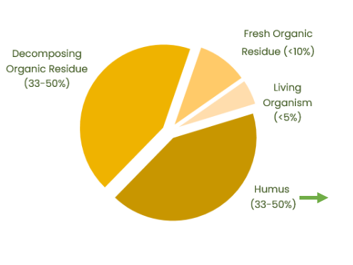
What is Humic Acid ?
Organic Matter is defined as anything that contains carbon compounds form by living Organisms
Humus
- “Complex variable carbon containing compounds not recognized under a light microscope as possessing cellular organization in the form of plant and animal bodies”
Organic Matter Breakdown

Slide 4
What are Humic Substances ?
From a Practical Standpoint:
Humic Substances are colloids comprised of humifed carbon derived from plant or animal remains
They constitute a critical fraction of Soil Organic Matter (OM)
They provide soils with structure, porosity, water holding capacity, cation &anion exchange, and chelation abilities
They can be sub-categorized into 3 groups:
Fulvic
Humic
Humin

Slide 5
How Humic Substances Function ?
Function as a cation exchange system that aids the soil’s ability to storehouse plant nutrients.
Contains trace micronutrients and minerals.
Because of smaller molecular size, easily enter plant roots, stems and leaves, transporting trace minerals directly to metabolic sites in plant cells
Humin
Because elements readily bind to humic acids in a form easily absorbed by plants & micro-organisms, are important in ion exchange & chelating systems
Humic Acid
Fulvic Acids

Slide 6
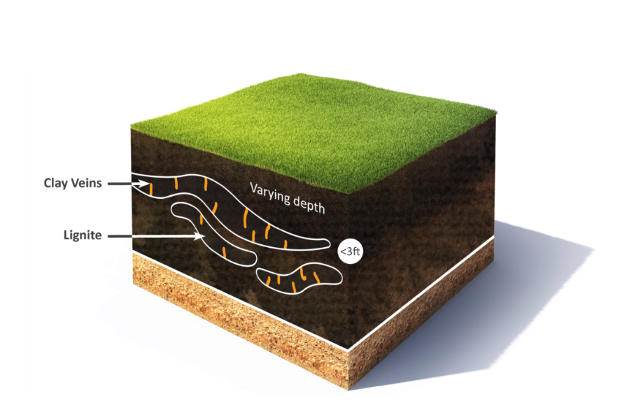
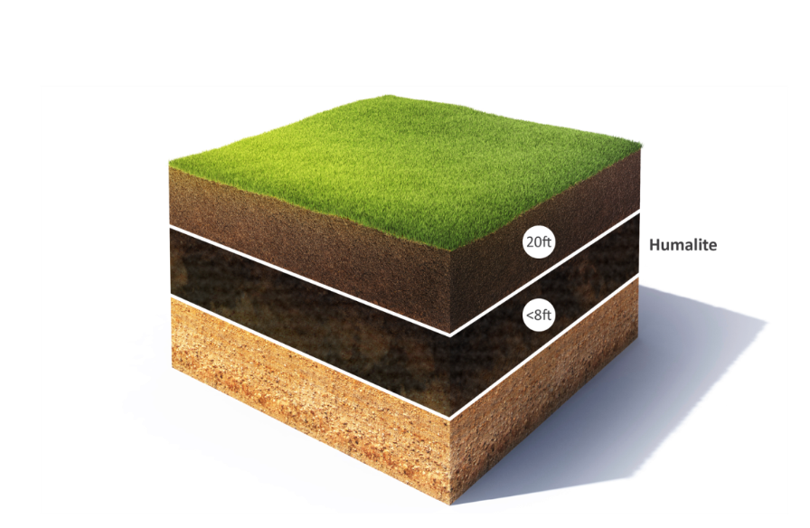
Types of Humic Deposits
Leonardite or Lignite
Humalite

Slide 7
Humic Sources
Lignite Coal
“Leonardite” Only
Sub- bituminous Coal
“Humalite”, from certain sources “Leonardite” from other sources
Named after Arthur Gray Leonard, the geologist who made the discovery, the term Leonardite was adopted as the name for all humic ore products​
Original definition was from layer above lignite sources only​
​
Humalites, while sometimes referred to as a Leonardite, are not truly a Leonardite because of different characteristics. ​
​
Humalite is found only in Alberta and parts of Saskatchewan and sits as a layer above the sub-bituminous coal.​
​
The differentiation comes from HOW they were formed ​
(salt water versus fresh water).​

Slide 8
Leonardite vs. Humalite
​ | Leonardite​ | Humalite​
Originates​ | From the layer above certain lignite coal layers around the world​ | From the layer above sub-bituminous coal layer in Alberta ONLY (due to freeze cycle)​
Formation​ | Formed in a salt water environment​ | Formed from a fresh water deposit​
Ash content​ | Generally higher than Humalites​ | Low​
Heavy Metals​ | Generally higher than Humalites​ | Low​
Humic Substances Percents​ | Due to source variability, ​ humic acid levels vary (10-78%)​ | Highest, consistent source of ​ Humic Acids (80+%)​
Fulvic Acid Percents​ | Variable, depending on source​ | Consistent​
Oxidizing​ | Slow​ | Quick​

Slide 9
Humic Acid Test Methods
Colorimetric
Method
Simple “qualitative” test
Additives such as lignosulfates can falsely elevate humic acid levels
CDFA Method
“California Department of Food & Agriculture” method
Currently only used by California & Oregon for registration & labelling
HPTA Method
“Humic Product Trade Association” HPTA method
Proposed as the industry wide standard method by the Humic Product Trade Association
Primary method for registration & labelling in most US and Canadian Provinces
Tends to give the highest results compared to other methods
Does not adequately account for ash content. Products with high ash content can falsely appear to have higher humic acid content
Currently regarded as most accurate analysis of humic content
Can separate the Humic and Fulvic molecules

Slide 10
Benefits of Humic
Soil Fertility
Biology
Structure
Chemistry
Nutrition
Microbial Activity
Soil Organic Matter
Crop Residue Breakdown
Erosion
Compaction
Water Retention
Cation Exchange Capacity (CEC)
Acidic Soils
Alkaline Soils
Nutrient Efficiency
Germination and Emergence
Nutrient Availability

Slide 11
Soil Microbes Balanced Diet: a Ratio
Carbon : Nitrogen
Energy producing
Builds Tissue
To stay alive, microbes need a C:N ration near 24:1
  Around 16 parts of C are for Energy
  Approximately 8 parts of C are for Maintenance
When this ratio is ideal for microbes, they release nutrients such as Nitrogen, Phosphorous and Zinc

Slide 12
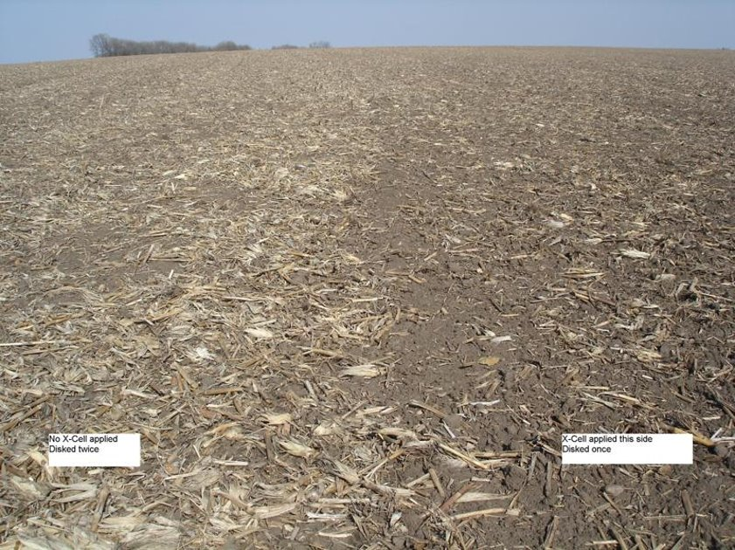
Crop Residue Breakdown
No Liquid Humic, Disked Twice
Application of 12% Humic, Disked Once

Slide 13
How do Humic Acids Effect Organic Matter ?
Humates are predominantly an organic carbon of very high quality
Added into the soil, humates provide a food source to microorganisms (carbon). This speeds up their reproduction and thus their activity. As a result:
  Nutrients cycle quicker
  Crop residue decomposition occurs quicker, therefore, adding to the organic matter
Carbon from the Humic Acid unavailable to microorganisms becomes part of the stable fraction of the soil’s organic matter.

Slide 14
Humics in the Soil
Collapsed soil structure
  Poor infiltration
  Poor root development
  Poor nutrient retention
Well Aggregated soil structure
  Increased water infiltration
  Better porosity, better root development
  Enhanced nutrient retention
H20
H20
H20
SOIL
particle
H20
H20
SOIL
particle
Humic
SOIL
particle
SOIL
particle
SOIL
particle
H20
SOIL
particle
H20

Slide 15
Water Holding Capacity
Organic matter influences the soil’s physical condition in several ways:
Increases the stability of soil aggregates and pores through bonding or adhesion properties of:
  Bacterial waste products
  Organic gels
  Worm secretions and casts
  Fungal hyphae
Organic matter particles have a charged surface that attracts water so it adheres, like a static cling
Adding Humic Acids
Because of the large surface area and internal electrical charges, humic substances function like water sponges. This gives them the ability to hold 7X their volume in water.
Humic acid also adds organic carbon, a food source for microbes. They in turn positively impact soil aggregates, which impacts soil structure – increasing air pores in soil, reducing compaction, etc.
http://www.fao.org/docrep/009/a0100e/a0100e08.htm
Water and dry weight – from Logic tables, Tesfay Teklay, p.7

Slide 16
Definition: Cation Exchange Capacity
Cation Exchange Capacity (CEC) is a calculated value that is an estimate of the soils ability to attract, retain, and exchange cation elements.
Measured in milliequivalents per 100 grams of soil (meq/100g)
The higher your soil’s measurement, the better the nutrient holding capacity of the soil

Slide 17
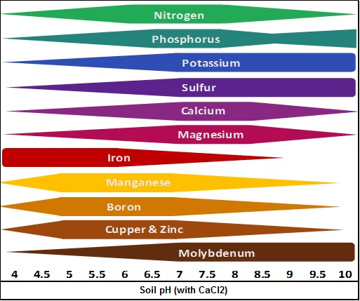
Nutrient Availability in Relation to Soil pH
Direction conventional fertilizers affect the soil

Slide 18
How Do Humic Substances Effect pH ?
The addition of Humic Acids frees up nutrients that are bound by pH conditions.
Humic acid is “amphoteric”
  Can donate or accept protons (H+)
Humic Acids therefore contribute buffering capacity in soil
  Balance the soil to a more neutral state.
  Net benefit?
More nutrients available to the crop

Slide 19

How Do Humic Substances Effect pH?
Salt (Salinity) is made up of a Cation and Anion
Addition of Humic’s, that humic will grab that Cation to pull it from the Anion to help elevate that salt pressure
What causes this, what is high in salt?

Slide 20
Feel Like You Need to Put More Fertilizer on to Get the Same Crop?
If the soil humus is not managed optimally, there are consequences to crop input requirements
As humic acids, INCREASE,
N-P-K needs DECREASE
As humic acids, DECREASE,
N-P-K needs INCREASE

Slide 21
Germination & Emergence
Humic acids helps seed germination by:
- Positive influence on ion transport, which improves cell permeability, thereby affects absorption
humic
Enhanced water / nutrient absorption
seed
humic

Slide 22


Benefits of Fulvic Acid
Benefits
  Natural Chelator (Highly water soluble)
    Allows for more flow in the plant
Helps improve the efficacy of the product its working with
  Great tank add for any crop input

Slide 23

Types of Humic Products
Raw Granular Products
Manufactured Products
  Semi-Soluble Granular
  Water Soluble Powder
  Liquids
What is the right product???

