Slide 1

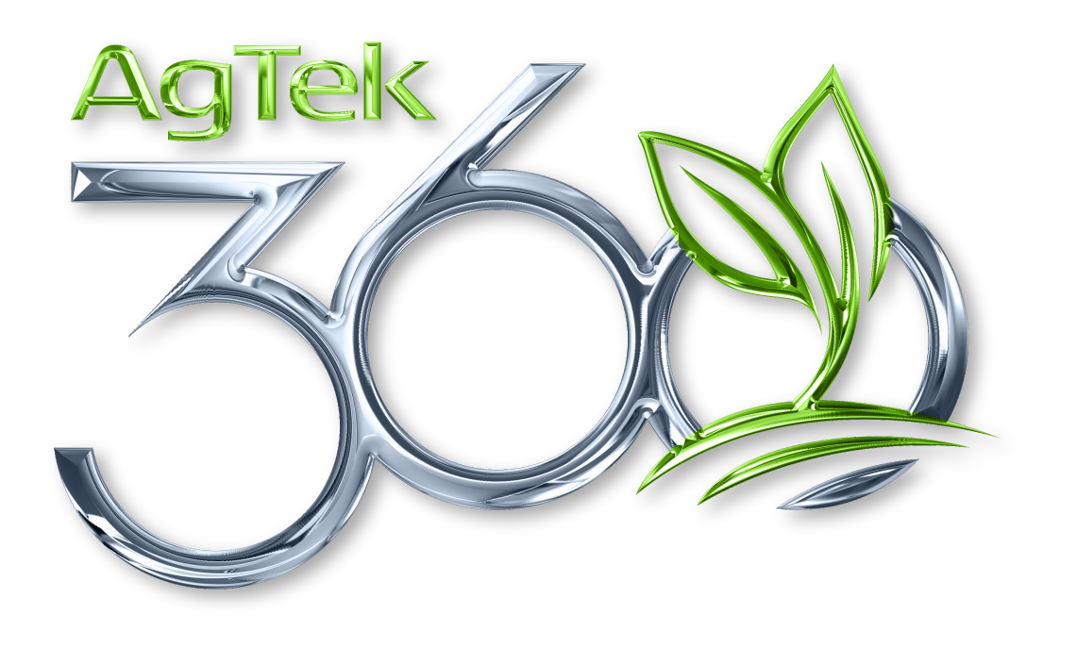
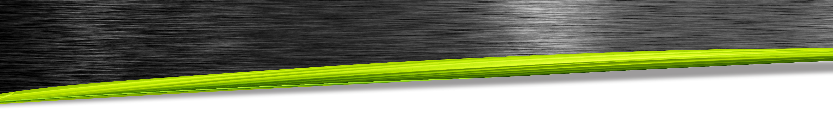
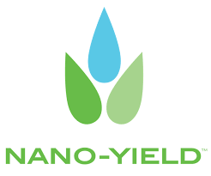
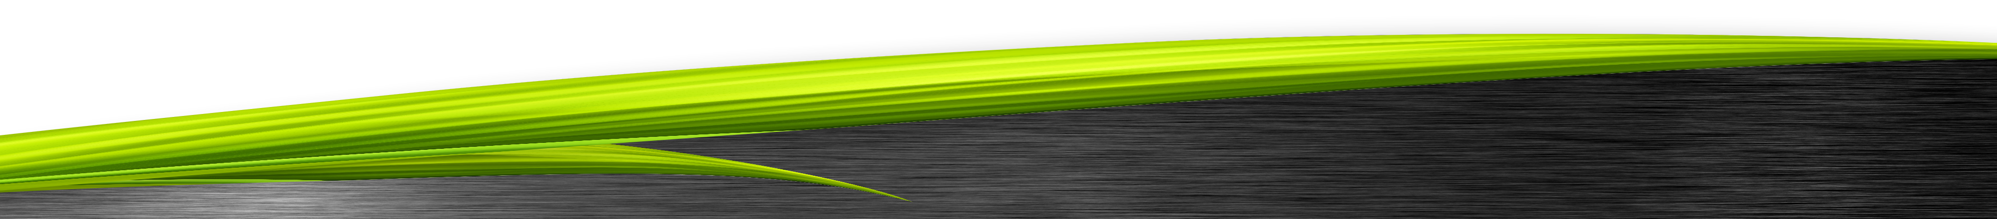

Nanoliquid® Technology
As a leading innovator in the field, Nano-Yield™ leverages nanotechnology to improve crop input efficiency. The new partnership with AgTek360 will provide Canadian producers with a new “tool” to enhance their input program.

Slide 2


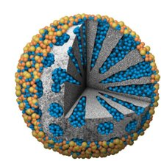
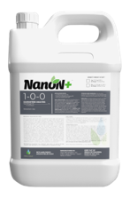
Benefits of Nanoliquid Technology
Advanced carrier for improved plant uptake
Low and affordable inclusion rates - 4 oz per acre
Enhances both nutrient and chemical products
$
$
Silica based nanoparticle
Your Program
Your Program
+ NanoliquidⓇ

Slide 3
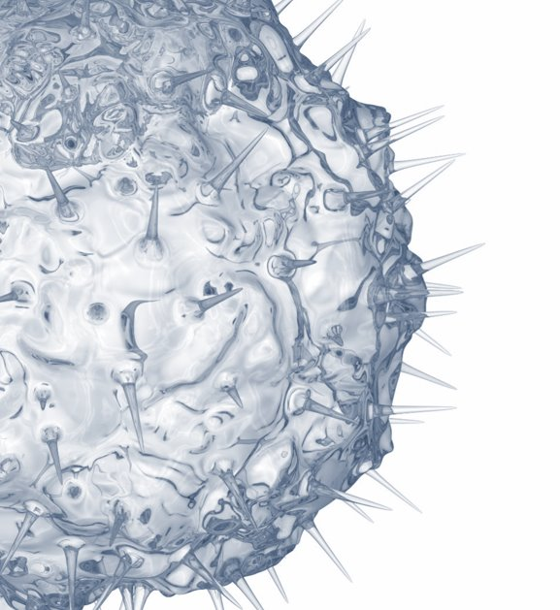
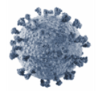
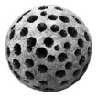
How small is nano?
“Nano” is generally considered <100 nanometers (nm)
Virus
Herbicide Molecule
(2 nm)
NanoliquidⓇ Technology
(10-100 nm)
Bacteria
(1000 nm)

Slide 4
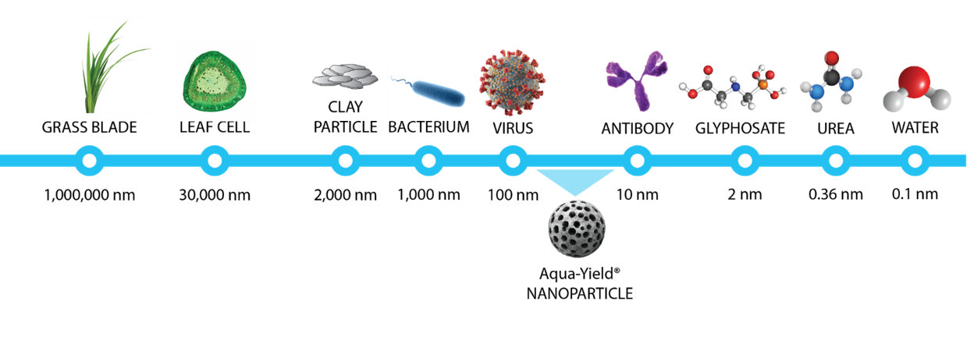
What is a NanoLiquid

Slide 5
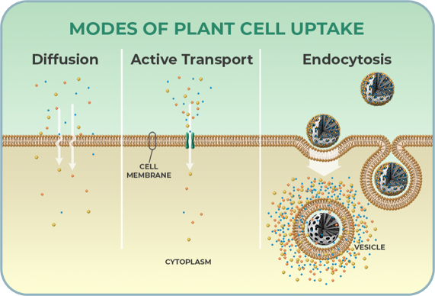
How does Nanoliquid® technology improve uptake?
Most crop inputs are absorbed via:
Diffusion
Active Transport
Nanoliquid® technology makes an additional mechanism possible.
Endocytosis - a mechanism cells use to rapidly absorb loaded nanoparticles i.e. “Trojan Horse”

Slide 6
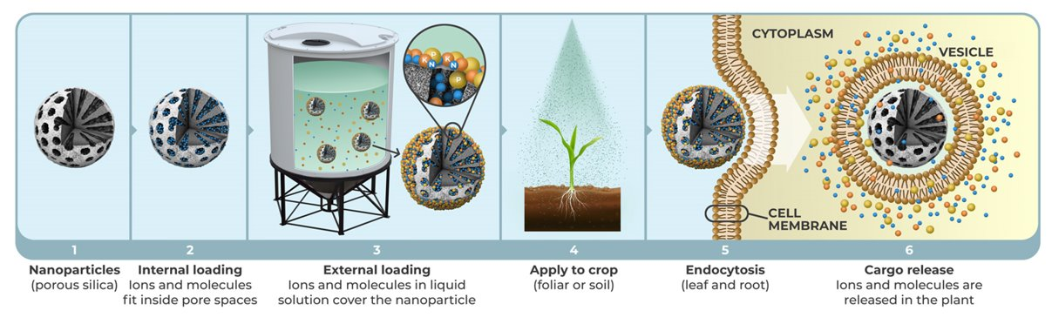
NanoliquidⓇ products improve plant uptake of nutrients and molecules in liquid solution

Slide 7
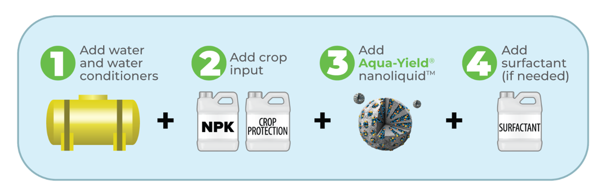
How to Use

Slide 8
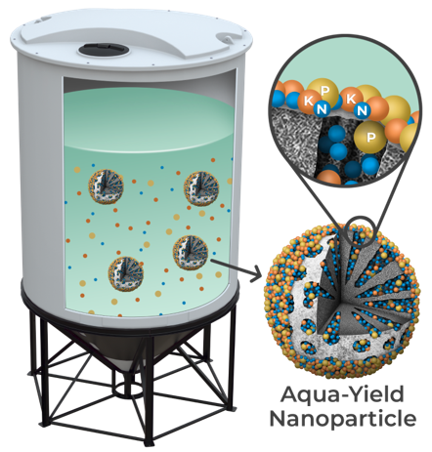
Mixing NanoN+ With Bulk Blends
Stable in all ambient conditions
Stable in solution for years
Will Not affect:
Salting out
Settling
Incompatibilities

Slide 9
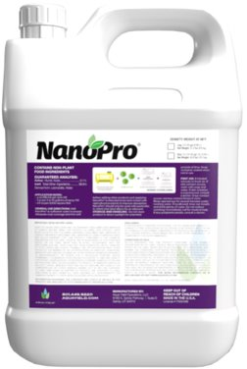
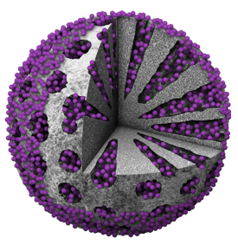
NanoPro Benefits:
NanoProⓇ Improves Active Ingredient Uptake
+20% more uptake on average
Supports reduced application frequency
Unique carrier technology
Highly compatible with most products
Application Opportunities:
Pre-Plant
Early Post
Post
Fungicide
Weed and Feed

Slide 10
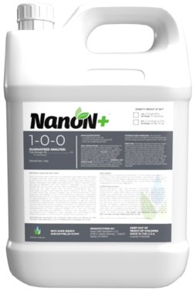
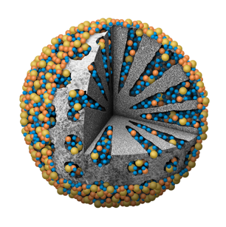
NanoN+Ⓡ improves Nutrient uptake
NanoN+ Benefits:
Enhances all nutrient uptake
Unique carrier technology
Compatible with most liquid fertilizers
Application Opportunities:
Starter Fertilizer
Sidedress
Y-Drop
Foliar Feed
Weed and Feed

Slide 11
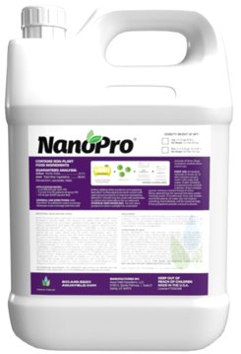
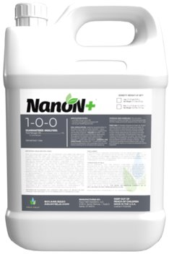
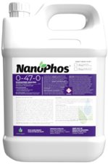
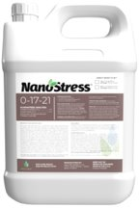
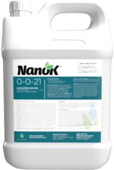
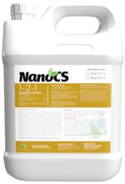
Carrier Only
Carrier + Nutrient

Slide 12


Slide 13
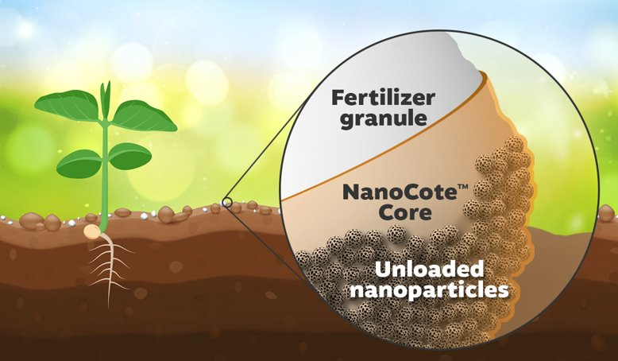
Biodegradable coating protects nutrients from environmental losses and surrounds the fertilizer product with nanoparticles
NanoCote™ Technology
Improves plant nutrient uptake
Reduces dust and buildup on fertilizer equipment
Protects nutrients from environmental losses

Slide 14
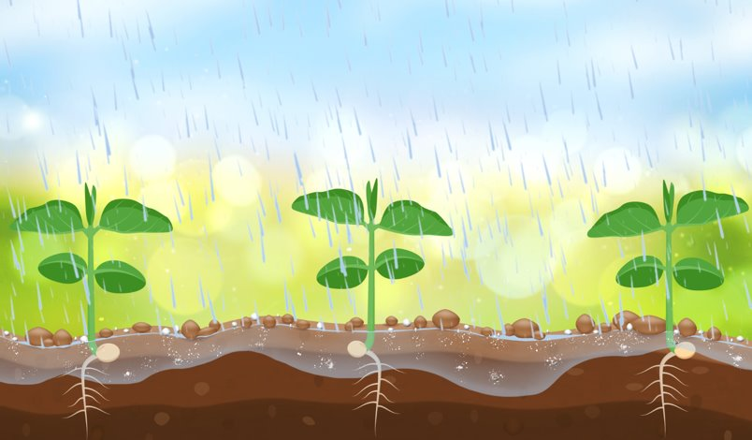
NanoCote™ Technology
NanoCote helps fertilizer and nanoparticles to disperse evenly in the root zone during the first irrigation or rain event

Slide 15
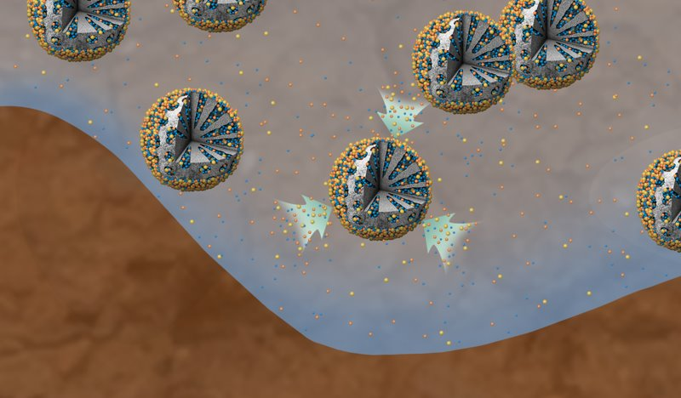
NanoCote™ Technology
Nanoparticles rapidly attract and load dissolved fertilizer ions and molecules, supercharging them with key crop nutrients

Slide 16
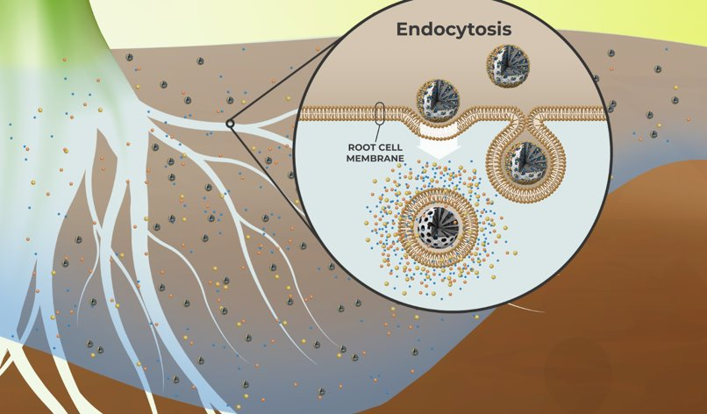
NanoCote™ Technology
Nutrient loaded nanoparticles protect the nutrients & facilitate faster uptake through endocytosis

Slide 17
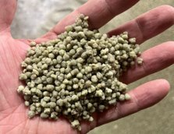
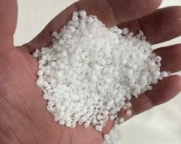
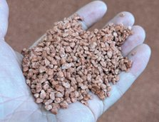
Fertilizers to “NanoCote”
2.5L to 3L per mT
Urea 46-0-0
Diammonium Phosphate (DAP) 18-46-0
Ammonium Dihydrogen Phosphate (MAP) 11-52-0
Ammonium Sulfate (AMS) 21-0-0-21S
Sulfate of Potash (SOP) 0-0-50
Muriate of Potash (MOP) 0-0-60
KMag 0-0-21-10Mg-21S

Slide 18
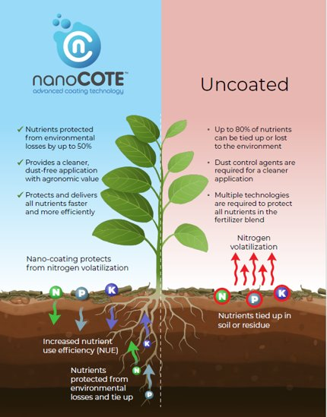
NanoCote Summary
Decreases nitrogen volatility
Increases phosphorus availability
Reduces dust 99%
“The all in one fertilizer coating”

