Slide 2
About Us

Slide 3

Values
Soil Stewardship:
  We prioritize soil health, conservation, and regeneration in everything we do.​
Customer Focus:
  We listen, learn, and adapt to meet the evolving needs of our customers.​
Integrity:
  We operate with transparency, honesty, and ethics in all our interactions.​
Collaboration:
  We build strong partnerships with suppliers, customers, and industry experts to drive positive change by knowledge and expertise exchange.

Slide 4

What Sets us Apart
Infrastructure
Manufacturing Plant:
  Total Area: 28,400 s. f. on 7.5ac​​
Production:
  12,400 s. f.​
Office/Lab:
  11,000 s. f.​
Covered Storage Bldg:
  5,000 s. f.​
**Immediate access to main highways​

Slide 5
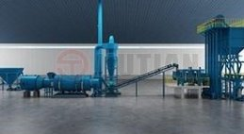


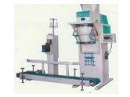
What Sets Us Apart
Technology
Production Capacity:​
Liquid Plant: 30,000L/ day
Dry Soluble Plant: 4,000k g/ day
  1st Canadian Manufacturer
  3rd North American Producer
  10th Globally (excluding the Chinese)
  Granular Plant: 40 Tn/ day
  Largest Canadian manufacturing capacity

Slide 6

What Sets Us Apart
Knowledge and Partnerships
Team of Experts:
Our team is equipped with exceptional skills and expertise, supported by strong partnerships, and possess a deep understanding and passion for innovation. We focus on consistently delivering high-quality results.​

Slide 7

What is Humic Acid?

Slide 8
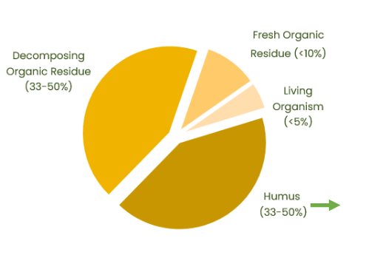
Organic Matter
Organic Matter is defined as anything that contains carbon compounds formed by living organisms
Humus
“Complex variable carbon containing compounds not recognized under a light microscope as possessing cellular organization in the form of plant and animal bodies”

Slide 9
What are Humic Substances
From a Practical Standpoint:
Humic Substances are colloids comprised of humifed carbon derived from plant or animal remains
They constitute a critical fraction of Soil Organic Matter (OM)
They provide soils with structure, porosity, water holding capacity, cation & anion exchange, and chelation abilities
They can be sub-categorized into 3 groups:
Fulvic
Humic
Humin

Slide 10
Humic Substances
Because elements readily bind to humic acids in a form easily absorbed by plants & micro-organisms, they are important in ion exchange & chelating systems
Because of smaller molecular size, they easily enter plant roots, stems and leaves, transporting trace minerals directly to metabolic sites in plant cells
Humin
Fulvic Acid
Humic Acid
Function as a cation exchange system that aids the soil’s ability to storehouse plant nutrients.
Contains trace micronutrients and minerals.

Slide 11
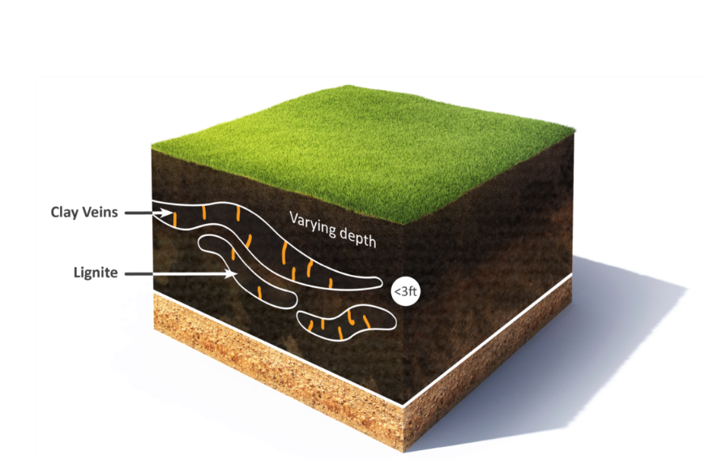
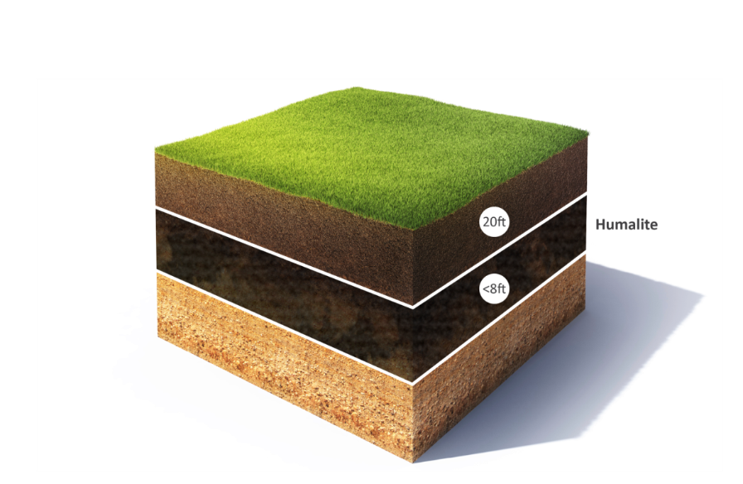
Types of Humic Deposits
Leonardite or Lignite
Humalite

Slide 12
Humic Sources
Lignite Coal
“Leonardite” Only
Sub- bituminous Coal
“Humalite”, from certain sources “Leonardite” from other sources
Named after Arthur Gray Leonard, the geologist who made the discovery, the term Leonardite was adopted as the name for all humic ore products​
Original definition was from layer above lignite sources only​
Humalites, while sometimes are referred to as a Leonardite, are not truly a Leonardite because of different characteristics. ​
Humalite is found only in Alberta and parts of Saskatchewan and sits as a layer above the sub-bituminous coal.​
The differentiation comes from HOW they were formed ​
(salt water versus fresh water).​

Slide 13
Leonardite vs. Humalite
​ | Leonardite​ | Humalite​
Originates​ | From the layer above certain lignite coal layers around the world​ | From the layer above sub-bituminous coal layer in Alberta ONLY (due to freeze cycle)​
Formation​ | Formed in a salt water environment​ | Formed from a fresh water deposit​
Ash Content​ | Generally higher than Humalites​ | Low​
Heavy Metals​ | Generally higher than Humalites​ | Low​
Humic Substances Percents​ | Due to source variability, ​ humic acid levels vary (10-78%)​ | Highest, consistent source of ​ Humic Acids (80+%)​
Fulvic Acid Percents​ | Variable, depending on source​ | Consistent​
Oxidizing​ | Slow​ | Quick​

Slide 14
Humic Acid Test Methods
Colorimetric
Method
Simple “qualitative” test
Additives such as lignosulfates can falsely elevate humic acid levels
CDFA Method
“California Department of Food & Agriculture” method
Currently only used by California & Oregon for registration & labelling
HPTA Method
“Humic Product Trade Association” HPTA method
Proposed as the industry wide standard method by the Humic Product Trade Association
Primary method for registration & labelling in most US and Canadian Provinces
Tends to give the highest results compared to other methods
Does not adequately account for ash content. Products with high ash content can falsely appear to have higher humic acid content.
Currently regarded as most accurate analysis of humic content
Can separate the Humic and Fulvic molecules

Slide 15

Benefits of Humic

Slide 16
What Can Humics Do?
Soil Fertility
Biology
Structure
Chemistry
Nutrition
Microbial
Activity
Soil Organic Matter
Crop Residue Breakdown
Erosion
Compaction
Water Retention
Cation Exchange Capacity (CEC)
Acidic Soils
Alkaline Soils
Nutrient Efficiency
Germination & Emergence
Nutrient Availability

Slide 17
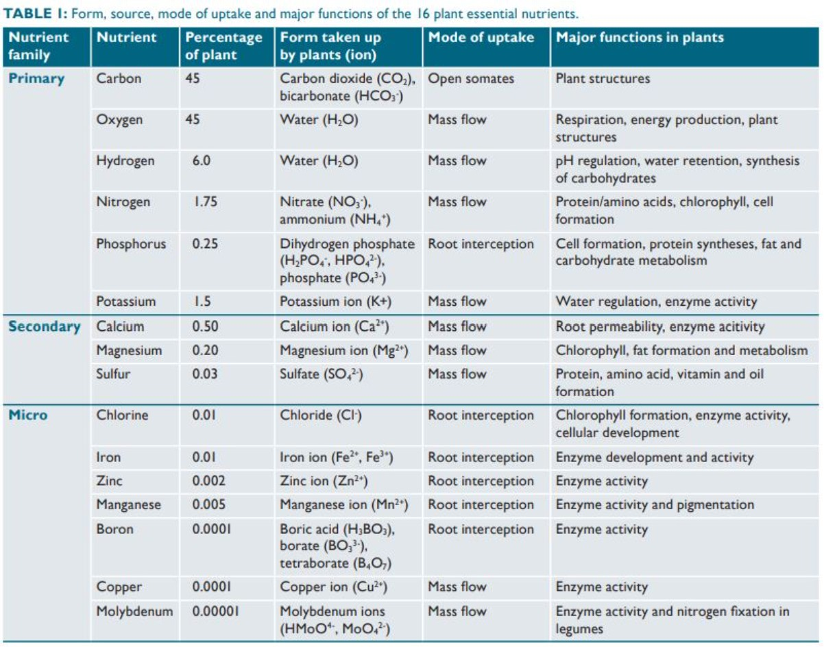

Slide 18
Soil Microbes Balanced Diet: a Ratio
Biology
Carbon : Nitrogen
To stay alive, microbes needs a C:N ratio near 24:1
Around 16 parts of C are for Energy
Approximately 8 parts of C are for Maintenance
When this ratio is ideal for microbes, they release nutrients such as Nitrogen, Phosphorous and Zinc
Energy Producing
Builds Tissue

Slide 19
How do Humic Acids Contribute to Increasing Organic Matter?
Biology
Humates are predominantly an organic carbon of very high quality
Added into the soil, humates provide a food source to microorganisms (carbon). This speeds up their reproduction and thus their activity. As a result:
  Nutrients cycle quicker
  Crop residue decomposition occurs quicker, therefore, adding to the organic matter
Carbon from the Humic Acid unavailable to microorganisms becomes part of the stable fraction of the soil’s organic matter.

Slide 20
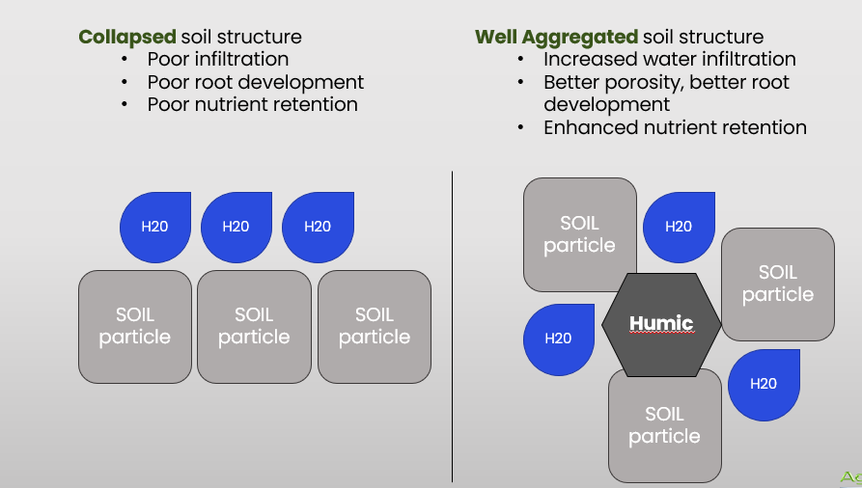
Humics in the Soil
Structure

Slide 21

Water Holding Capacity
Structure
Organic matter influences the soil’s physical condition in several ways:
Increases the stability of soil aggregates and pores through bonding or adhesion properties of:
  Bacterial waste products
  Organic gels
  Worm secretions and casts
  Fungal hyphae
Organic matter particles have a charged surface that attracts water so it adheres, like a static cling
Adding Humic Acids
Because of the large surface area and internal electrical charges, humic substances function like water sponges. This gives them the ability to hold 7X their volume in water.
Humic acid also adds organic carbon, a food source for microbes. They in turn positively impact soil aggregates, which impacts soil structure – increasing air pores in soil, reducing compaction, etc.
This Photo by Unknown Author is licensed under CC BY-NC

Slide 22
Definition: Cation Exchange Capacity
Chemistry
Cation Exchange Capacity (CEC) is a calculated value that is an estimate of the soil’s ability to attract, retain, and exchange cation elements.
Measured in milliequivalents per 100 grams of soil (meq/100g)
The higher your soil’s measurement, the better the nutrient holding capacity of the soil
Humic’s Typical CEC is around 175 – 400 meq/100g, most soils would average low double digits.

Slide 23
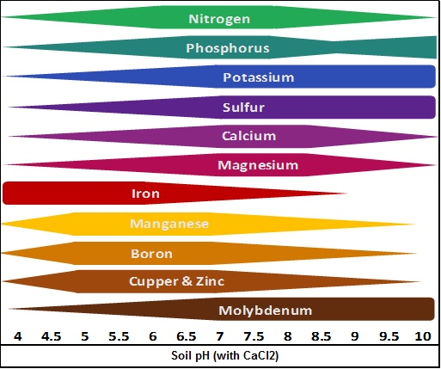
Nutrient Availability in Relation to Soil pH
Chemistry
Direction conventional fertilizers affect the soil

Slide 24
How does Humic Substances Affect pH?
Chemistry
The addition of Humic Acids frees up nutrients that are bound by pH conditions.
Humic acid is “amphoteric”
  Can donate or accept protons (H+)
Humic Acids therefore contribute buffering capacity in soil
  Balance the soil to a more neutral state.
  Net benefit?
More nutrients available to the crop

Slide 25

Salinity….
Chemistry
Salt (Salinity) is made up of a cation and an anion
With addition of humics, the humic will grab the cation to pull it from the anion to help elevate the salt pressure
What causes this? What is high in salt?

Slide 26
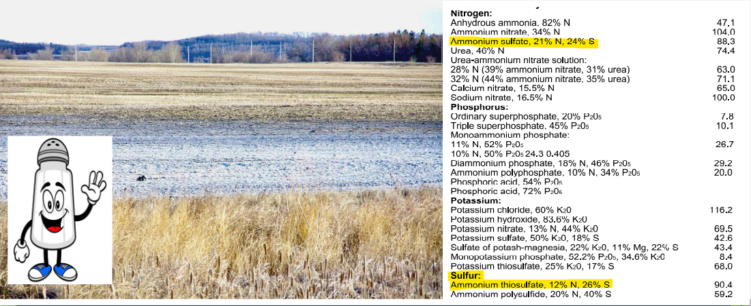
Salt Index on Fertilizer Material
Chemistry

Slide 27
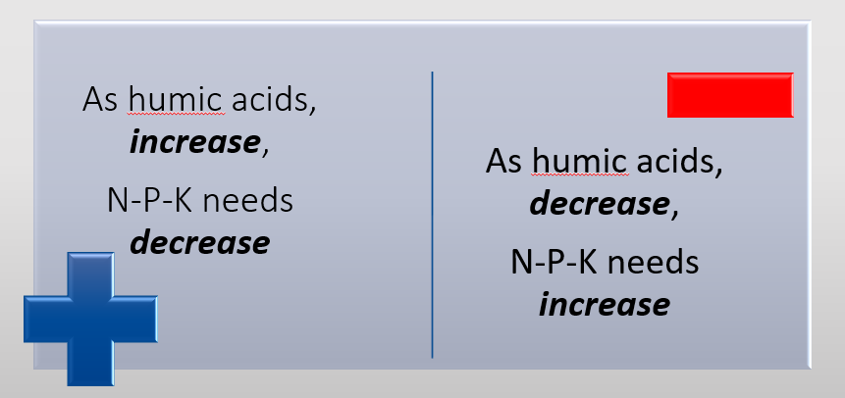
Feel like you need to put more fertilizer on to get the same crop?
If the soil humus is not managed optimally, there are consequences to crop input requirements

Slide 28
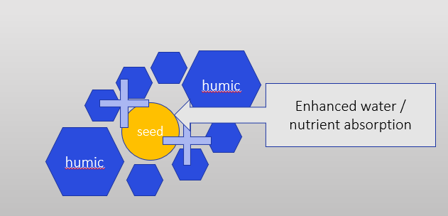
Germination & Emergence
Nutrition
Humic acid helps seed germination by:
Positive influence on ion transport, which improves cell permeability, thereby affects absorption

Slide 29
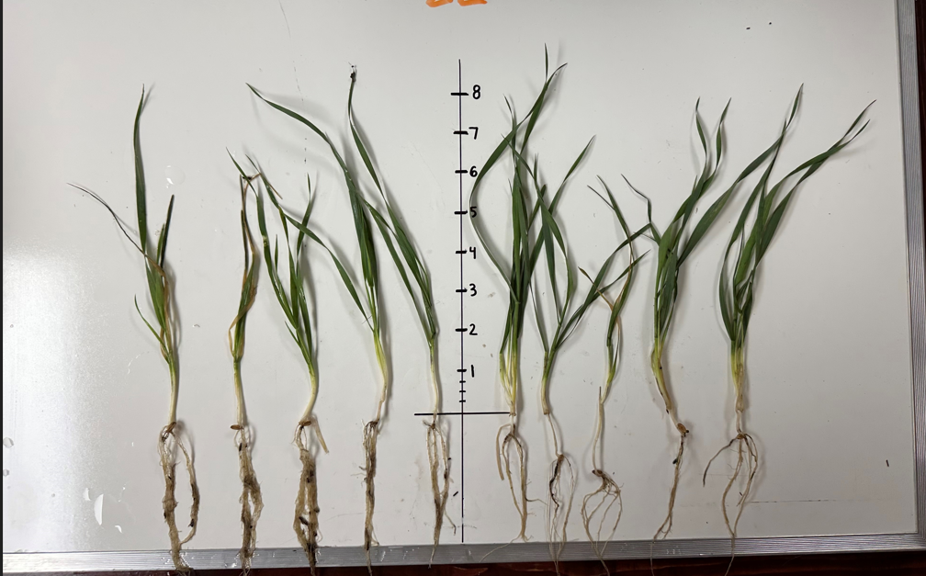
Treated vs. Untreated

Slide 30

Full Fertility vs. Humic Treated with less Fert.

Slide 31

What is the right product?
What are you trying to fix?
What application method works for you?
Liquid or Granular

Slide 32


Slide 33

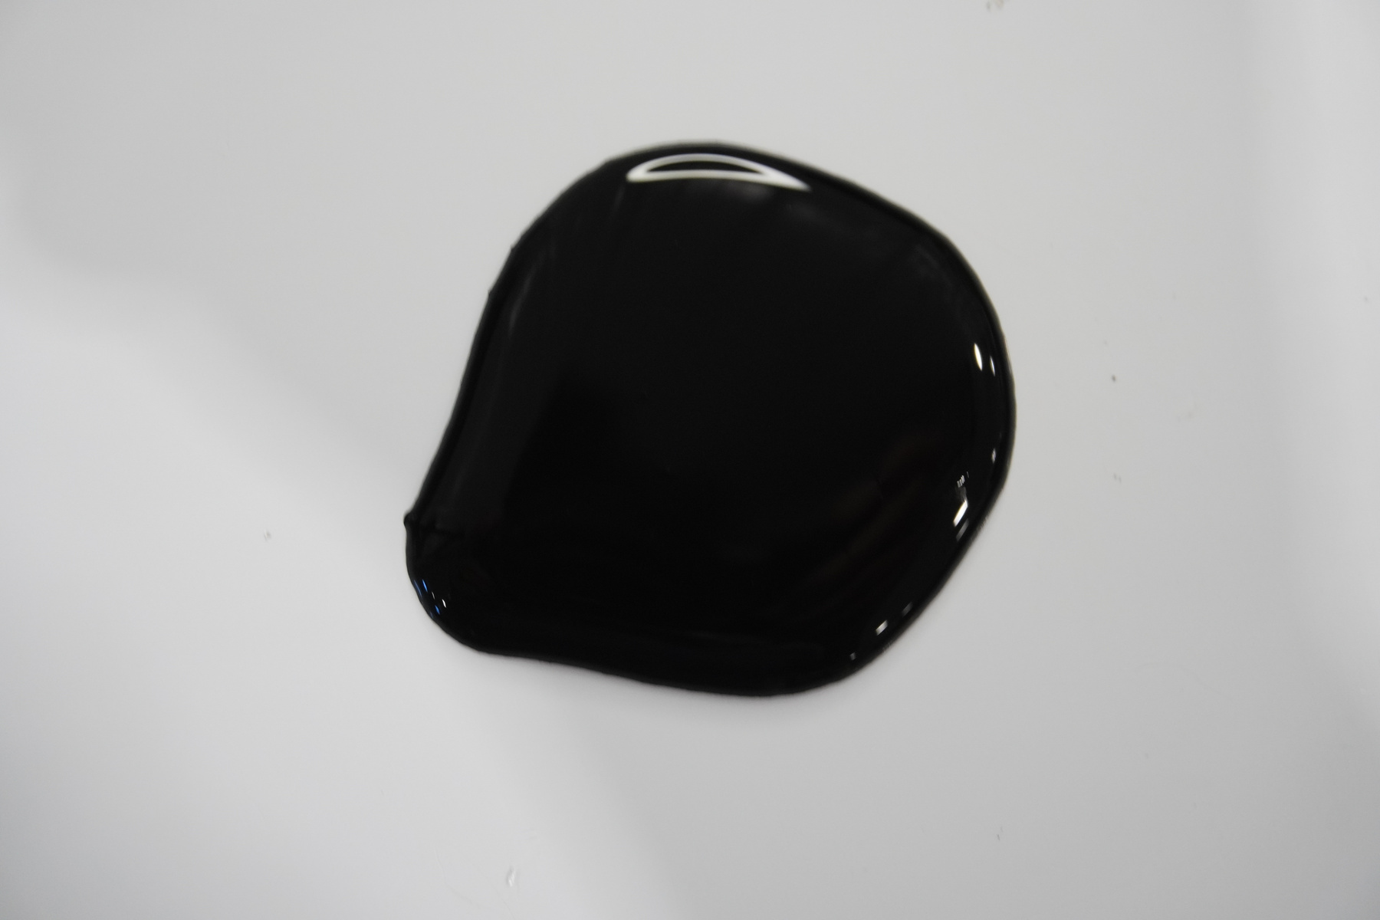
Energy L-24
Energy L-12
is a highly concentrated liquid humic extraction ideal for starter fertilizer applications, top dressings, and irrigation systems. It can also be applied as a stand-alone soil conditioner as well as a dry fertilizer impregnation.
Humic Substances .......... 24% Colorimetric
Fulvic Substances ............ 6.9 ISO 19822
Organic Carbon ................ 5.2%
pH................................................. 13
C:N ratio .................................. 15:1
Density .......................... 1.1 kg/L
is a liquid humic extraction ideal for starter fertilizer applications, top dressings, and irrigation systems. It can also be applied as a stand-alone soil conditioner as well as a dry fertilizer impregnation.
Humic Substances .......... 12% Colorimetric
Fulvic Substances ............ 3.8 ISO 19822
Organic Carbon ................ 3.4%
pH................................................. 12.5
C:N ratio .................................. 15:1
Density .......................... 1.1 kg/L

Slide 34
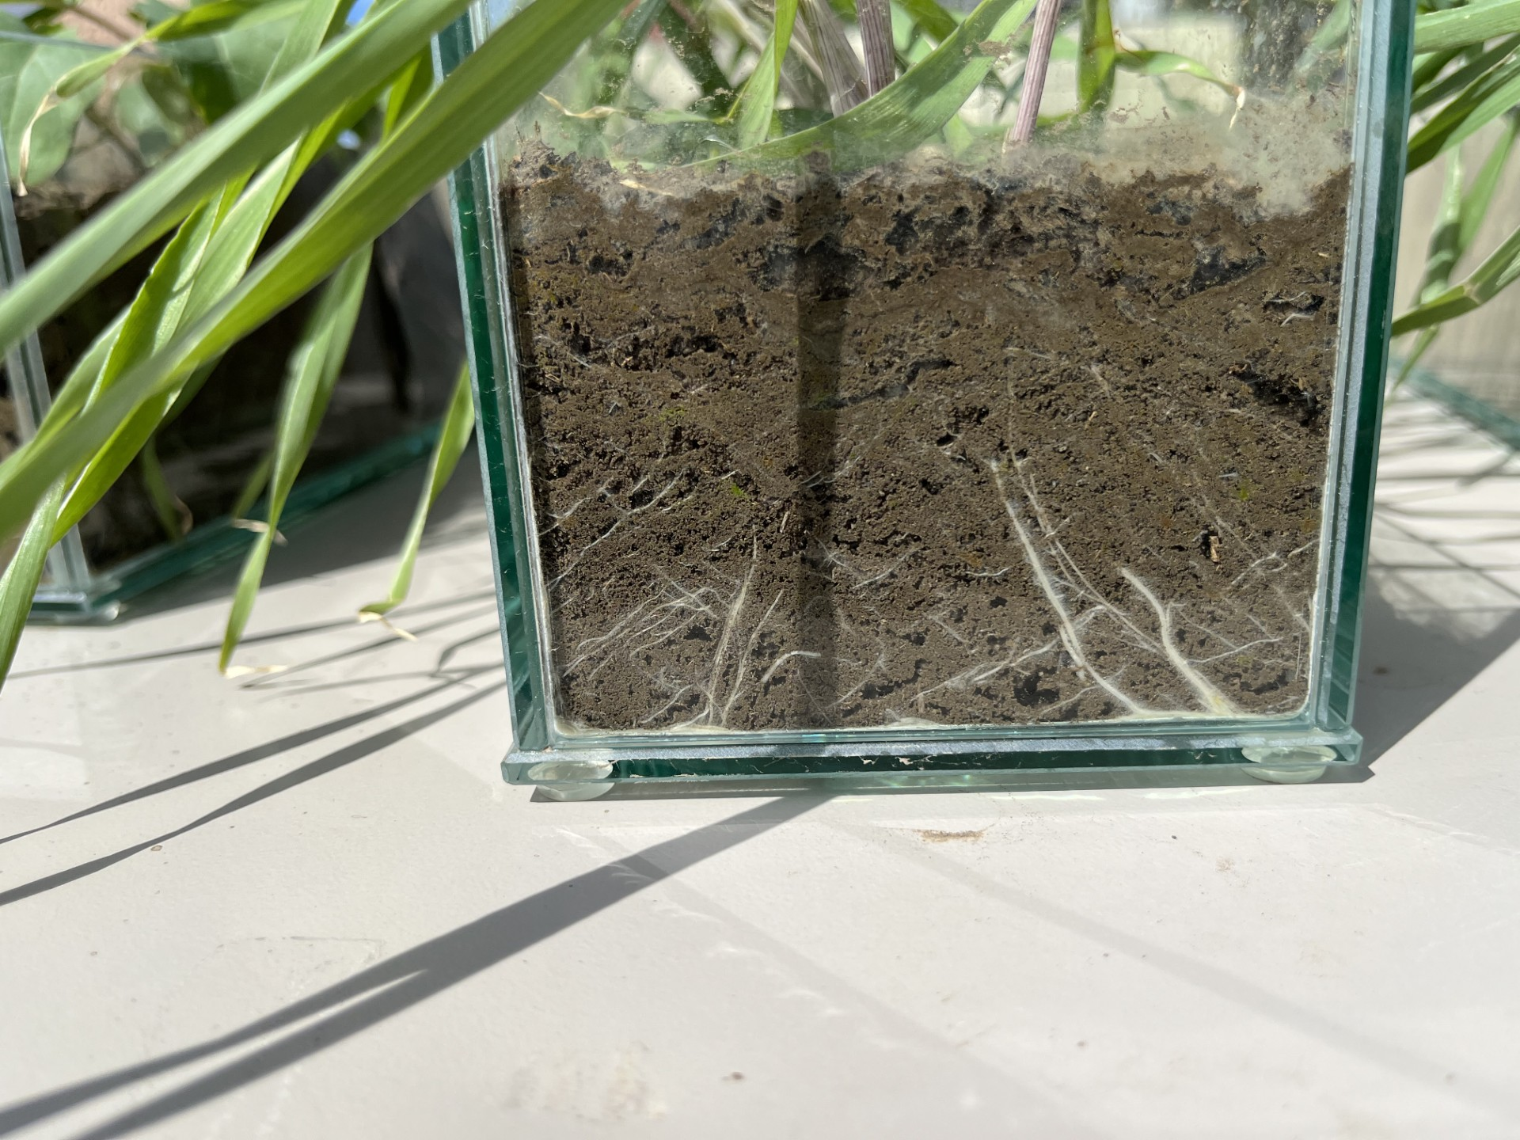
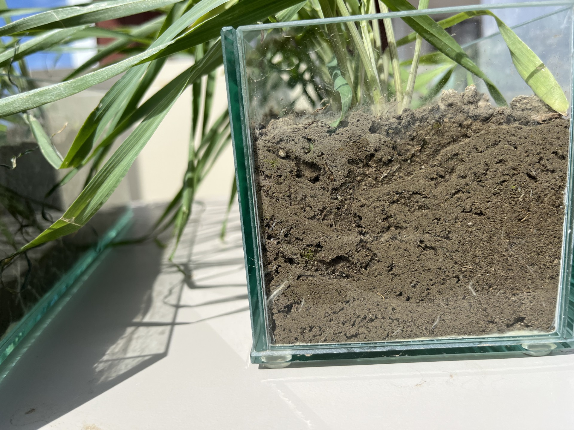
L-24 No Liquid Humic

Slide 35
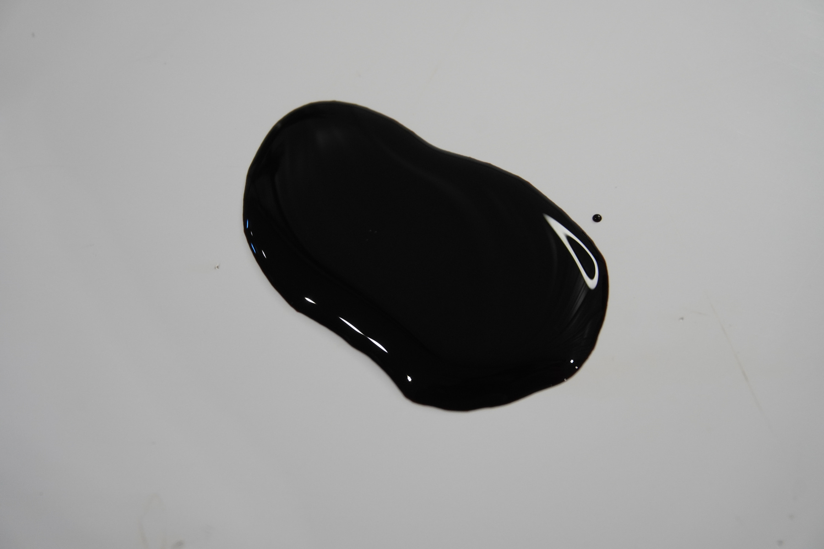

Energy L-Fusion
Energy L-Fulvic
is a low-concentrated liquid humic extraction designed to blend with a wide range of liquid fertilizers, fungicides, and herbicides. Its special formulation will potentialized and increase the efficiency of any application. ​
​
Humic Substances .......... 6% Colorimetric​
Fulvic Substances ............ 1.5 ISO 19822​
Organic Carbon ................ 1.5%​
pH................................................. 7.6 ​
C:N ratio .................................. 9:1​
Density .......................... 1.0 kg/L
is a high-concentrated liquid Fulvic extraction designed to enhance foliar and foliar nutrient applications. 100% compatible with most liquid crop input, increasing uptake and penetration through the root and leaf.​
​
Fulvic Substances ............ 3.5 ISO 19822​
CEC.............................................. 175 - 400 Meq/100gr​
Organic Carbon ................ 0.6%​
pH................................................. 4 ​
C:N ratio .................................. 5:1​
Density .......................... 1.0 kg/L

Slide 36

Fulvic Benefits
Benefits
  Natural Chelator (Highly water soluble)
    Allows for more flow in the plant
  Helps improve the efficacy of the product its working with
    Great tank add for any crop input

Slide 37
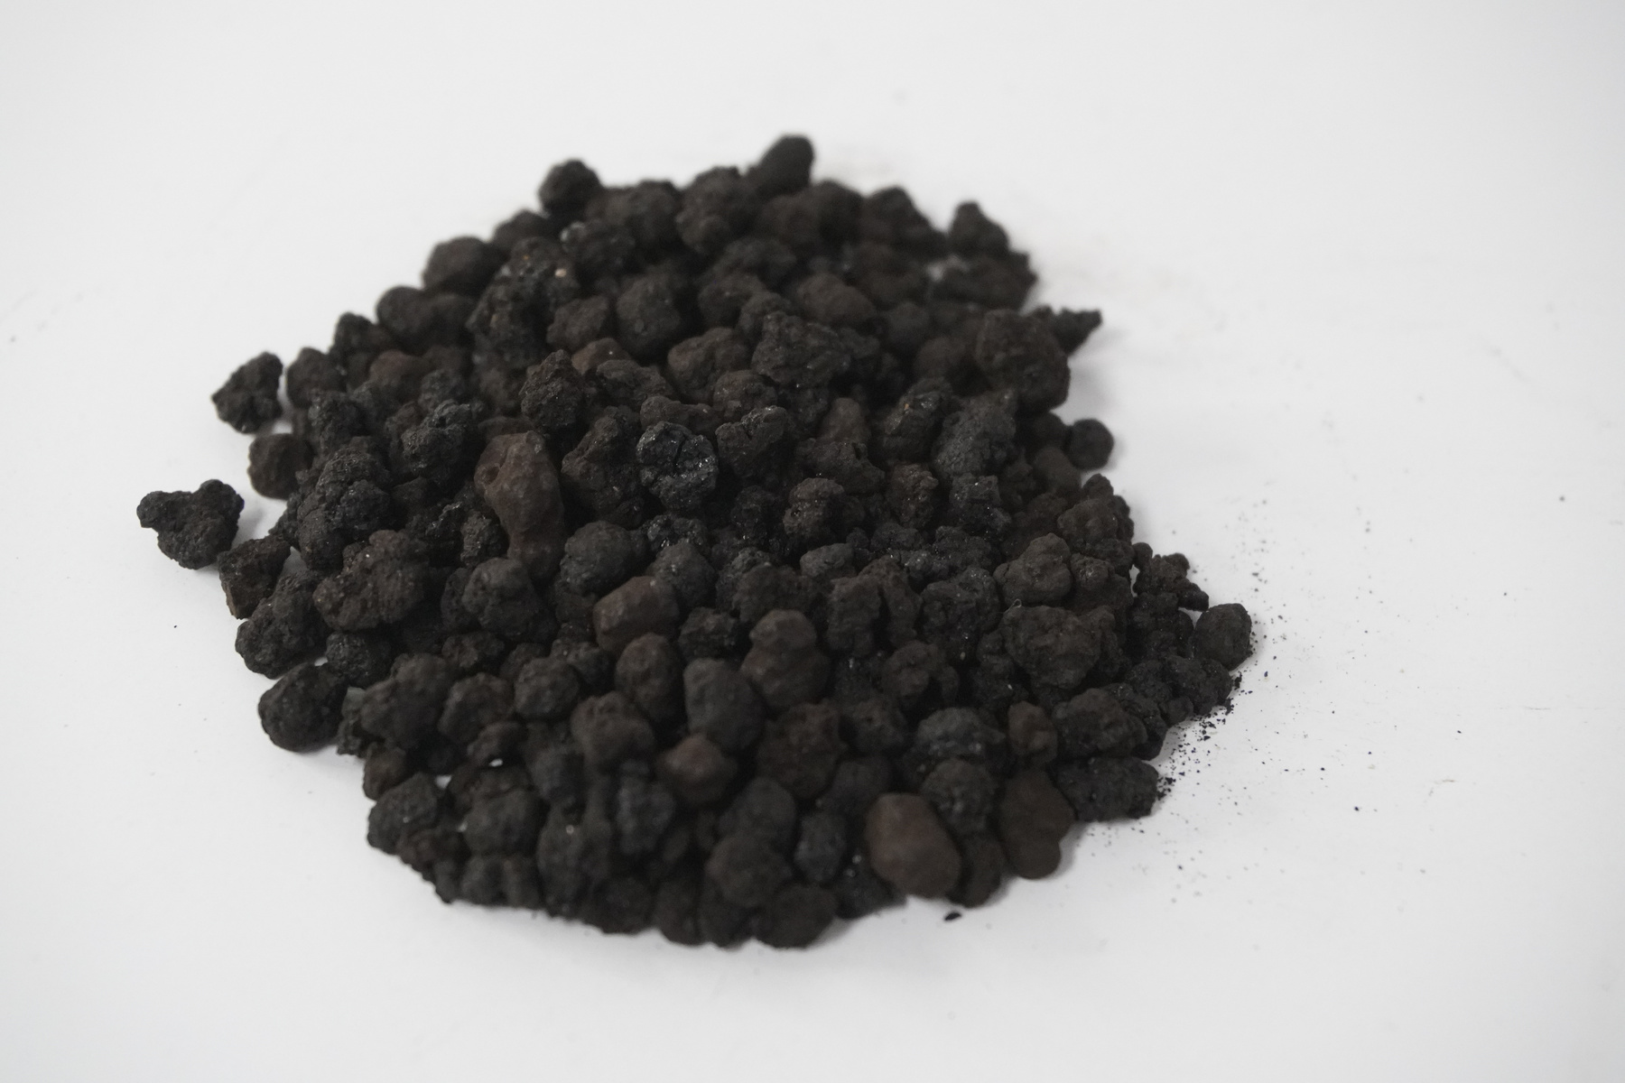
Power Coarse
is a semi-soluble granular humic product, compatible with most fertilizers, that provides the quick short benefits of a liquid humic and the long-lasting effect of a raw granular. Its convenience and efficiency adapts to all farm operations and soil types.
Humic Substances .......... +64% Colorimetric
Organic Carbon ................ 33%
pH................................................. 10
C:N ratio .................................. 42:1
Moisture .................................. 10-12%
Bulk Density .......................... 640kg/m³ or 40lb/ft³

Slide 38


Calgary Golf Course
Year 1 Spring to Mid Summer
Year 3
Raw Humalite @ 10lbs/ 1000 sq/ft
Man. Granular Humic @ 4lbs/ 1000 sq/ft
Raw Humalite @ 5lbs/ 1000 sq/ft
Man. Granular Humic @ 2lbs/ 1000 sq/ft

Slide 39

Thank You
Questions?
Katelyn Miller
Business Development Manager
kmiller@soilsynergy.ca
(780) 237-6037

