Slide 1

-ing is Believing
Carbon: A Keystone of Soil & Plant Health

Slide 2
What does healthy soil do to create a profitable crop?
Brady & Weil, The Nature and Properties of Soils, pg 4
Notes:
Soil provides the following for plants:
Physical support
Air Supply & Flow
Supports respiration (energy release for growth)
Water
Supports cooling, nutrient transport, and photosynthesis (energy production)
Temperature moderation
Protects plant roots
Protection from toxins
Ventilate gases; decomposition or absorption of toxins
Nutrients essential for growth

Slide 3
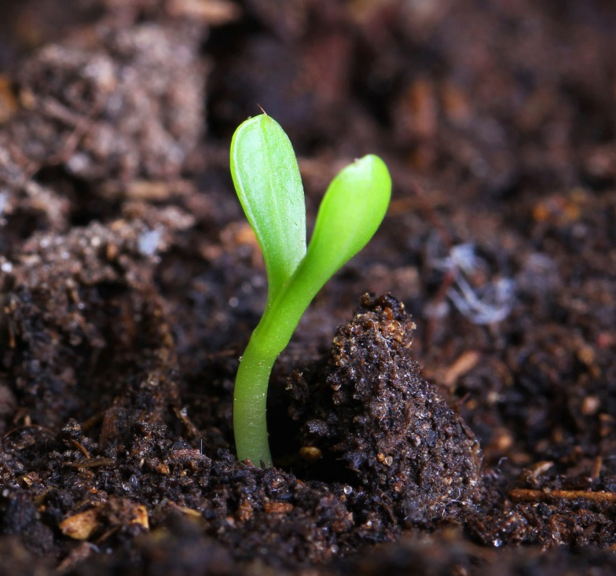
3 Fundamentals of Soil Life
Essential mineral nutrients
Beneficial soil microorganisms
Organic matter
Photo Copyright Huffington Post

Slide 4
Essential Mineral Nutrients
Soils supply plants with the mineral nutrients they need for optimum growth.
Macronutrients: needed in large amounts
P, K, Ca, Mg, S
Micronutrients: needed in small amounts
Cu, Co, Fe, Mn, Ni, Zn, B, Cl, Mo
Brady & Weil, The Nature and Properties of Soils, pg 7

Slide 5
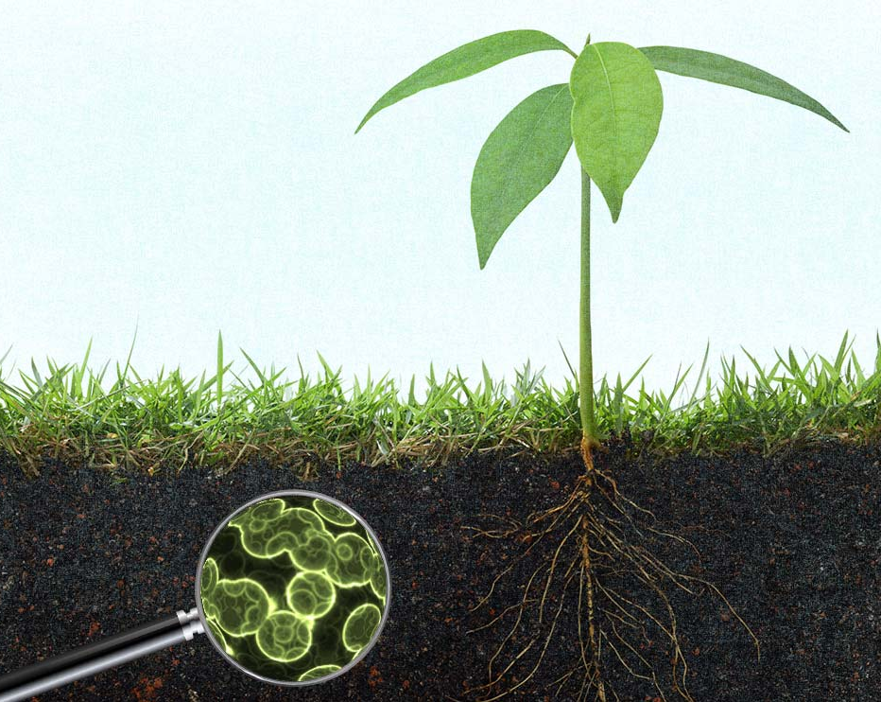
Beneficial Soil Microorganisms
Functions:
Make nutrients available to plants in the organic form
Promote soil structure
Produce plant growth hormones
Protect plant from pathogens
Photo Copyright Modern Farmer
Sylvia, Principles and Applications of Soil Microbiology, pg 257
Notes:
Microorganisms are an essential part of the soil ecosystem.
The A&L Agronomy Handbook states, “Because of the important contributions made by bacteria to the fertility level of the soil, life of higher plants and animals could cease if the functions of the bacteria were to fail.”

Slide 6
Soil Microbes…
From The Biological Farmer by Gary Zimmer (book published in 2000)
“Beneficial soil organisms are a “voluntary army” willing to work tirelessly for you, if only you will let them. If you provide them with a comfortable “home” (soil with air and moisture), food (organic matter), a good mineral balance and freedom from toxic chemicals, they will go to work. If you feed the soil microbes, they will feed the crop.”
Organism | Number Per Acre | Pounds Per Acre
Bacteria | 800,000,000,000,000,000 | 2,600
Actinomycetes | 20,000,000,000,000,000 | 1,300
Fungi | 200,000,000,000,000 | 2,600
Algae | 4,000,000,000 | 90
Protozoa | 2,000,000,000,000 | 90
*These numbers are populations for a temperate grassland soil

Slide 7
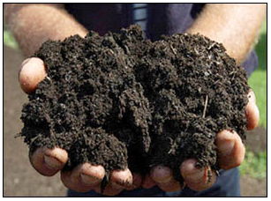
Soil Organic Matter
… from Wikipedia;
“Soil organic matter (SOM) is the organic matter component of soil, consisting of plant and animal residues at various stages of decomposition, cells and tissues of soil organisms, and substances synthesized by soil organisms.”
Picture credit; http://blog.albertsorganics.com/?p=1173

Slide 8
“We have lost 50% Soil Organic Matter in North America since 1950” Dr. James Hoorman The Ohio State University Extension Educator, Agriculture and Natural Resources

Slide 9
Functions of Soil Organic Matter
Carbon sequestration
Reservoir for nutrients
Water storage
Food for soil organisms
Brady & Weil, The Nature and Properties of Soils, pg 515
Notes:
When in sufficient supply, soil organic matter performs the following functions…
Carbon sequestration
Reservoir for nutrients (N, P, B, etc.)
Nutrients can be attached to the organic matter or a component of the organic matter itself. The nutrients are slowly released by mineralization. 1% Soil organic matter can hold 1000 pounds of nitrogen per Acre
Promotes aggregation
important for soil structure and aeration
Water storage
absorbs water like a sponge & retains it for plant growth
Food for soil organisms

Slide 10
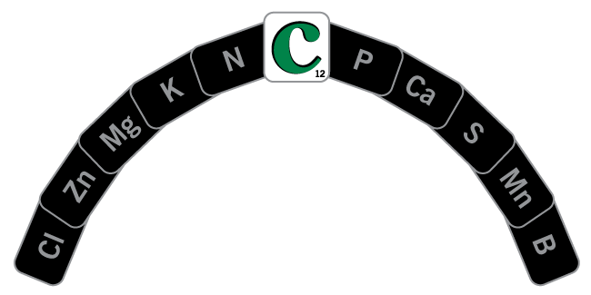
The Importance of Carbon
C is the keystone for all soil physical, chemical and biological processes and properties.
C can be a limiting nutrient, just like N, P, K, or other nutrients.
Sheaffer, et al, Introduction to Agronomy, pg 280
Archuleta, Plant and Soils are One, https://www.youtube.com/watch?feature=player_embedded&v=FQEKlm4DOdw
Notes:
Our soils are carbon depleted because of the conversion of native vegetation to cropping. It is estimated that the US is responsible for the loss of 51 million tons of soil organic carbon due to conversion of land.
In addition to the conversion of native vegetation to cropping, agricultural practices also promote carbon loss:
Soil erosion by wind and water
Tillage
Removal of plant residue from fields

Slide 11
The major organic constituent of Humus is Humic Substances
Humic Compounds
Fulvic
Acid
Humic
Acid
Humins
Molecular chain-length increases
Highly water soluble
slightly water soluble
Highly insoluble
Humic DG contains humic substances mirroring the final decomposition products of humus in soil
Notes:
Humic substances comprise about 60-80% of soil organic matter.

Slide 12
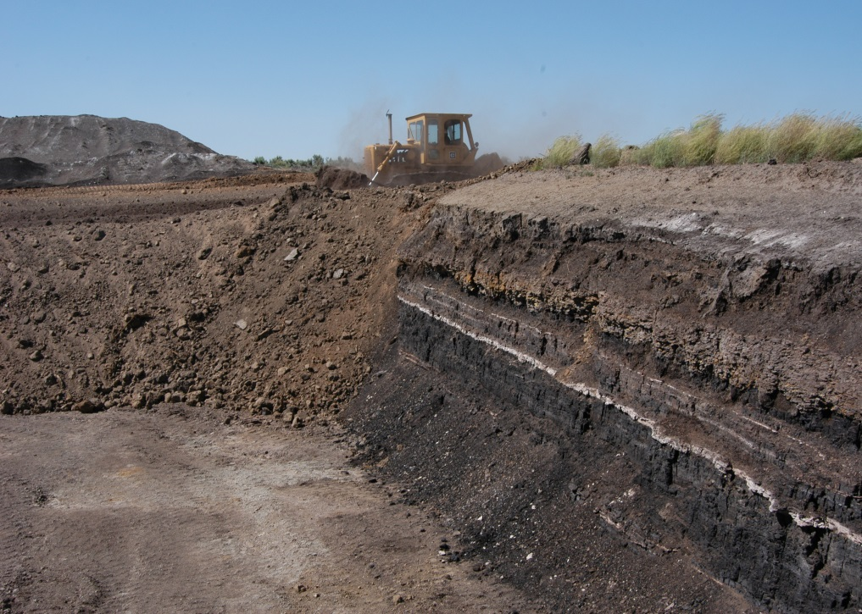
Concentrated Humic Acid
Formed by microbes breaking down organic substances. (oxidized lignite)
Found near surface unlike coal

Slide 13
Humic Acid …..HUMIC DG
How does it work?
Complexing of nutrients in the soil (Chelation)
Increases soil microbial life (HDG - 48% C)
Increases “CEC” holds nutrients from leaching soil and water stability
Improves root mass and initiation. (glomalin)

Slide 14
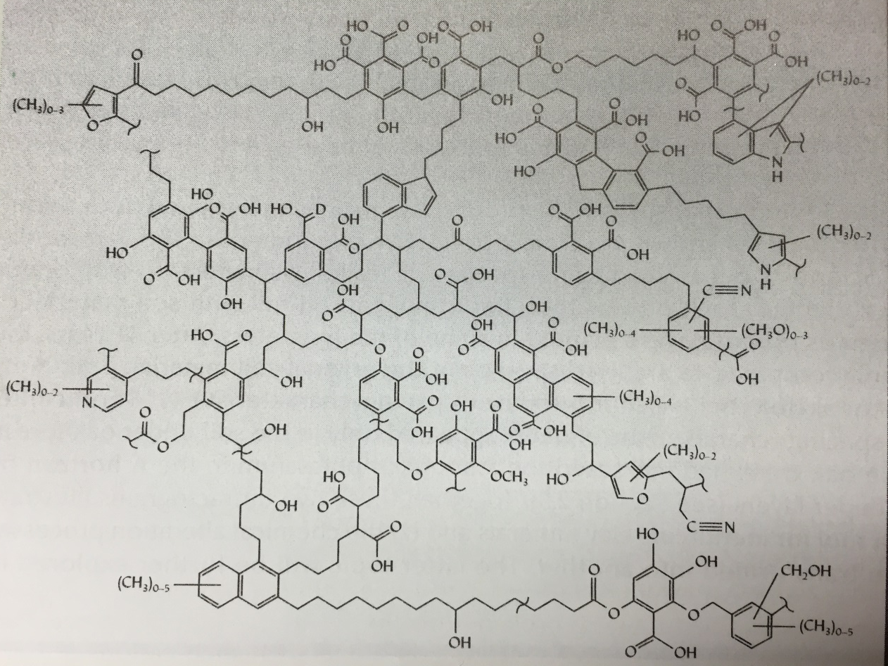
Chelation; Complexing
Carboxyl and hydroxyl groups can react with nutrients, which can lead to:
Chelation
Complexation
Carboxyl and hydroxyl groups in
a humic acid molecule
Humic Acid Structure; Figure 8.14, Brady & Weil, The Nature and Properties of Soils

Slide 15
Humic vs. Biochar
Biochar will not have the Carboxyl and Hydroxyl groups until microbes do their part in the soil
… Eventually Biochar will become Humic Acid in the soil
Carboxyl and hydroxyl groups in
a humic acid molecule
Humic Acid Structure; Figure 8.14, Brady & Weil, The Nature and Properties of Soils

Slide 16
Humic Acid Nutrient Efficiency
In a study conducted by Dr. Mike Fidanza at Penn State University in 2015, statistically similar turf quality and color were observed when comparing:
Humic DG with 16-0-8 applied at 0.77 lb N/1000 ft²
16-0-8 (No Humic DG) applied at 1 lb N/1000 ft²

Slide 17
The higher the number, the more microbial activity present.

Slide 18
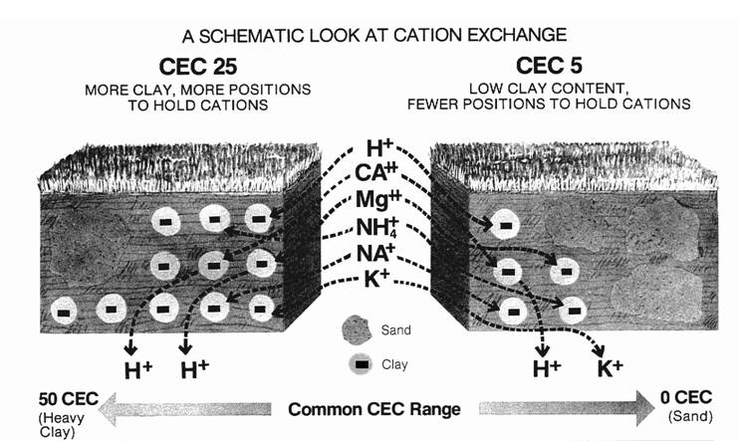
Granular Humics add C.E.C.
Adds cation exchangeable material to the soil
High CEC = high nutrient retention and fertility
Humus (150-250)
HIGH CEC
LOW CEC
Humic Acid (600+)
Sand (9)
Clay (30)
0 300 600+
milliequivalent
Brady & Weil, The Nature and Properties of Soils, pg 341, 514;
http://aggie-horticulture.tamu.edu/newsletters/hortupdate/hortupdate_archives/2002/jun02/art4jun.html
http://www.spectrumanalytic.com/support/library/ff/CEC_BpH_and_percent_sat.htm

Slide 19
Science of HS root mass Improvement initiation
HS can stimulate plant growth in terms of increase in plant length and dry or fresh weight.^{47,48} These effects seem to depend on the concentration⁴⁹ and source of HS and plant species
Many studies have confirmed the hypothesis of a direct effect of HS on plant physiology, in particular concerning root hair formation⁵¹ and lateral root development.^{23,24,52}
HS hormone-like activity is expected as it is known that soils vary in their native auxin content⁷⁸ and fertile soils contain greater amounts of auxin then less fertile ones.^{79,80} Auxin and gibberellin levels are usually higher in the rhizosphere than in the bulk soil, probably as a consequence of increased microbial populations or of an accelerated metabolism owing to the presence of root exudates.
Auxin Type activity of HS, demonstrated in recent studies, is probably the main biological factor responsible for the positive effects exerted by HS on plant physiology. Response to HS, has been found mainly in the first stages of root initiation, when cells start to divide. HS response may involve mechanisms as the stimulation of cell division and differentiation, which it is know to be under the control of auxin.
H.Khaled, H.Fawy : Soil and Water Resources 6,2011 (1):21-29

Slide 20

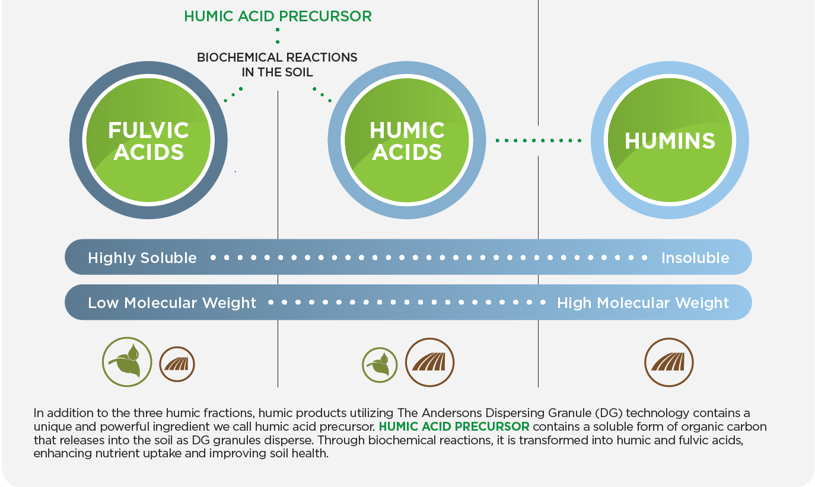

Contains all three final break down products of Humus
www.AndersonsHumates.com

Slide 21
Humic Substances
Humics are used on 12+ million Acres in North America (3% of total)
Growing Global market – probably double digits
North America ~150,000 tons

Slide 22
Humic Substances – Commercial forms
Liquids- 6-20 % 12%, 6-12% Typical
Micronized powders- 20-50%
Mined Granules- 35-80% HA
Pelletized Granules - HUMIC DG (70-80%)

Slide 23


Humic Substances; Soil vs Foliar Particle Size

Slide 24
Important Factors Selecting A Humic Sustance
Source
Concentration
Chelating / Complexing Capacity
Processing – (particle size/ sieve seize)
Soils

Slide 25
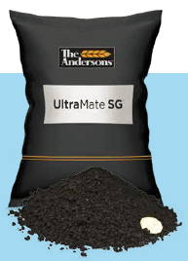
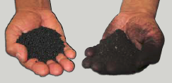
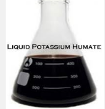

Humic Acid – Chemical extraction; Raw Humate > Potassium Humate > Sulfonated Potassium Humate
Physically processed
Raw Aggregate
Liquid Humates
Soluble powder or granules
Sulfonated Soluble powder or granules

Slide 26
Mesa Verde Humates

Slide 27
Surface area matters
When adding non–soluble materials to soil
Mesa Verde Humates

Slide 28
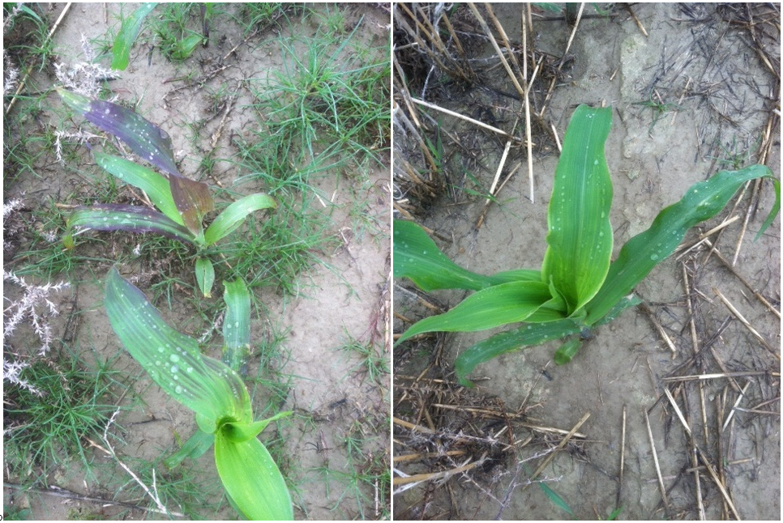
Works on all plants
Humic acids get more from our land with less input.
Humic DG
10 lbs/acre
Untreated

Slide 29
Crops showing improvement:
Increased root growth (length & number) observed after application; Improvement in leaf size and productivity :
Group 1: Corn, tomato, cucumber, wheat , pepper, carrot, milo,cotton bentgrass.
Group 2: Green beans, sugar cane , sugar beets, canola, strawberries ,alfalfa, oats, dry beans, lentils, blueberries, lettuce
Group 3: soybeans, fruit trees, peanuts
Academic Studies: Cooper (1998), Adani (1998), Arancon (2006), Quilty (2011)

Slide 30
Commercial Humates in Agriculture: A Viable Substance?
“Liquid Humate application and pelletised humates at application rates sufficient to have an effect, targeted to the seedling rhizosphere for a variety of crops in low C sandy and saline soils.”
Graham Lyons 1 and Yusuf Genc, 2016 University of Adelaide

Slide 31
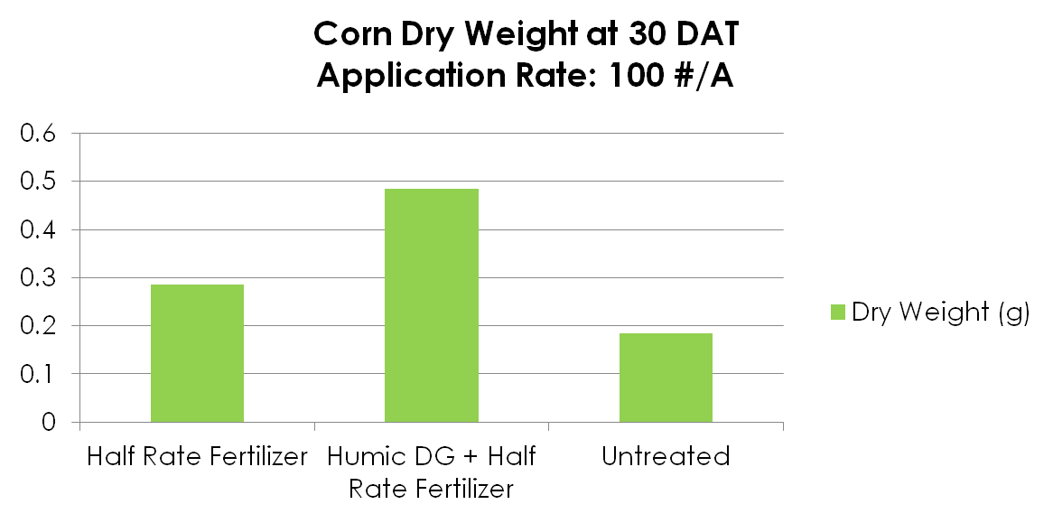
2011 Nutrient Efficiency Study The Ohio State University
31
When applied along with a half rate fertilizer application, [Product X] resulted in greater dry weight compared to half rate fertilizer alone.
Notes:
31

Slide 32
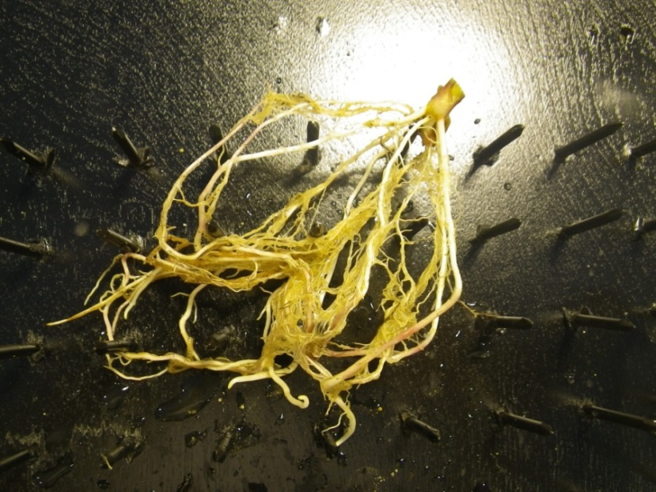
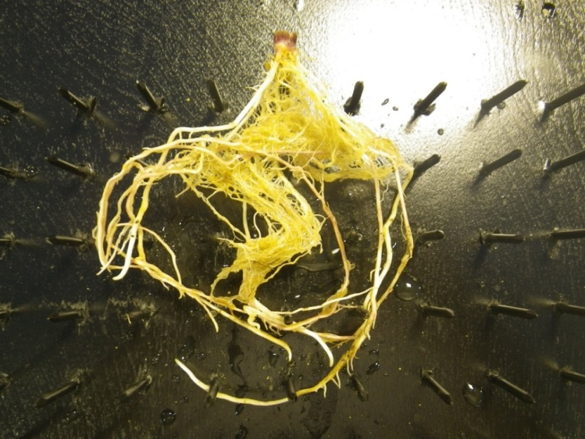
Nutrient Efficiency
Half Rate Fertilizer
+ 100 lb/acre Humic DG
Half Rate Fertilizer
2011 Study at Ohio State University

Slide 33
2014 Arise Research Study
Nitrate Activity and Crop Yield in a Field Lysimeter Laboratory
All treatments received grower standard
P (200#/ac) & K (200#/ac)
30 gal/ac UAN broadcast preplant and incorporated
30 gal/ac UAN sidedressed
Control
Humic DG - 10#/ac plus 3 gal/ac of 6-24-6 starter placed 2 x 2
Ultramate SG –1#/ac dissolved in UAN sidedressed
2 repetitions; 5 wells; 4 rows spaced at 30”

Slide 34
Nitrate Lysimeter Well Study 2014
Corn – Bushels per Acre
+54.0

Slide 35
Nitrates (Environmental Impact of Nitrogen)
Huge decrease in nitrates leached in this study
4x decrease in nitrates leached in this study
Source: Arise Research & Discovery, 2014
Replicated 2 times

Slide 36

Soil Amendment
Dispersing Homogenous Granule Technology
Thousands of sub particles = More surface area (activated)
70% Humic acid - contains all three humic components: Fulvic, Humic and Humin
Important to getting full humic acid benefit
Also contains ‘Humic acid precursor’ - Non-Humic Carbon, Organic Acids, (activator), Polysaccharides
Easy to handle and use
Blends with Dry Fertilizer, Spreads, available in a growing season
www.AndersonsHumates.com

Slide 37
What powers Humic DG differently …..
Super fine particles of
Humate are most effective,
but horrible to apply… So …

Slide 38
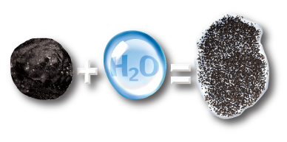
Humic DG and Black Gypsum DG: What Drives Efficiency?
Sub Particle Size
Self Incorporation
Dual Carbon Source

Slide 39


Rainfall or Irrigation
+
=
Formulation
Immediate Phase Change for enhanced soil-based delivery
39
Notes:
nutrient and/or active ingredient "carriers" that target enhanced delivery of value added chemistry to agricultural crops such as Turf, Ornamental Landscapes, Food Crops or in some cases, pest control situations. The term "carrier" is typically used when describing a granule that transports active ingredients from point A to point B. Advanced Granules however, are immediately activated with irrigation, rainfall or dew to perform a function that enhances the value added delivery.
There are currently three types of Advanced Granules: Soil Dispersing, Foliar and Foaming Granules.

Slide 40
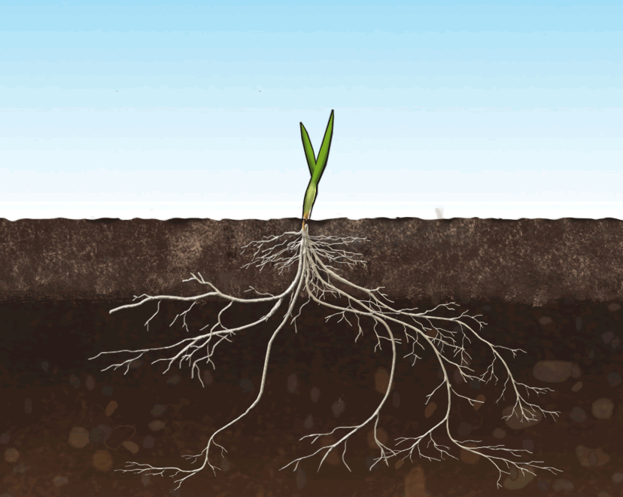


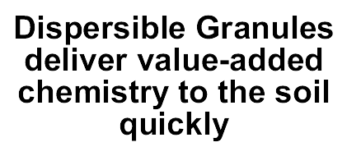
May persist for weeks or longer on the surface

Slide 41
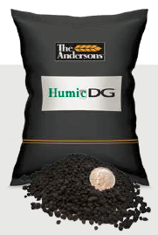
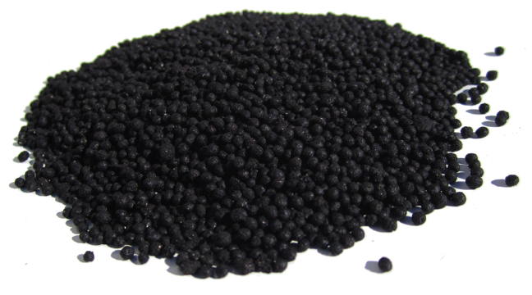
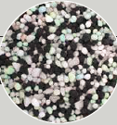
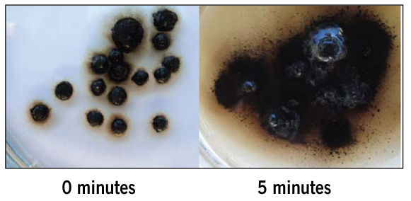
Humic Acid enhanced with the DG formulation
Dispersible Spreadable Blendable

Slide 42
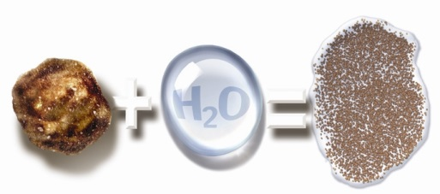
DG technology overview
DG = Dispersible Granule
Disperses into soil (self – incorporation) with about 10 min irrigation or rain
Increases particle count to roughly 700,000 per square inch
Consistently delivers better efficacy
Excellent spreadability (spherical)

Slide 43
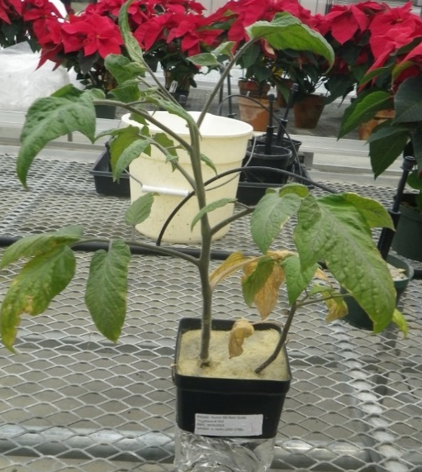
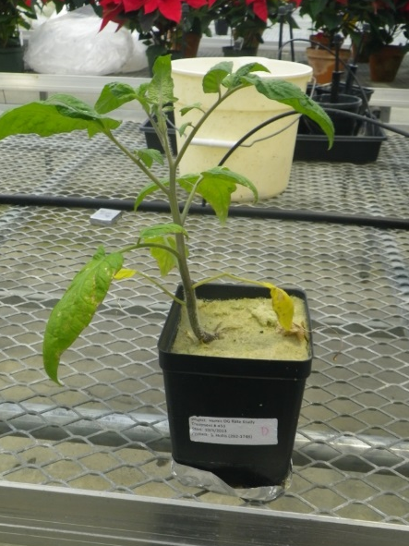
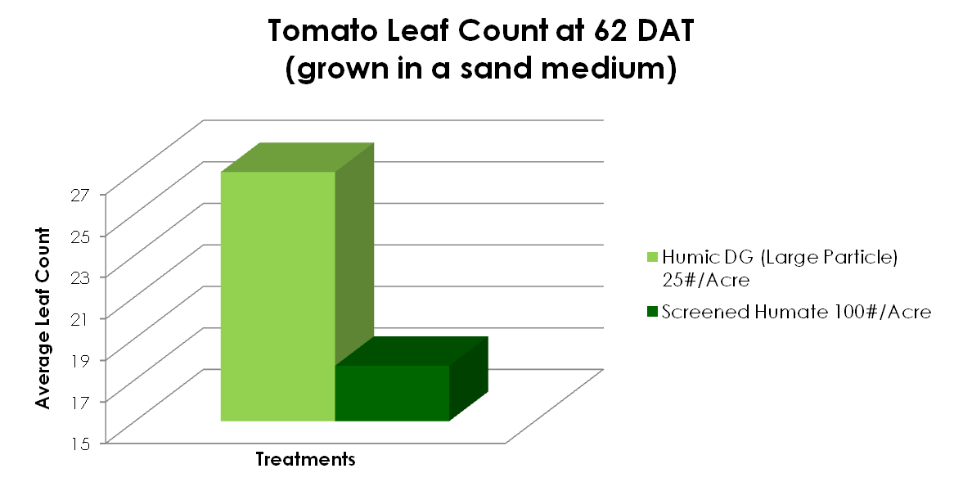
Dispersible Formula is up to 4x more effective vs mined Humates

Slide 44
Greenhouse, 2013
Comparable or greater performance was observed after applications of Humic DG, as compared to screened humate applied at a 4x greater rate.
Increased performance due to:
Dispersible Granule (DG) Technology
Self incorporation into the soil
Humic Acid Precursor
Two Sources of Humic Substances
Immediate activity in soil and increased availability over time, as compared to the single source of screened humate
Spherical Prill
Improved coverage and solubility

Slide 45
FEATURES:
DG technology allows for improved availability in soil solution
Quicker and longer availability to crops
Enviromentally friendly:
Increase water penetration into soil, retains soil moisture
Reduces nutrient volatilization and increases nutrient uptake particularly Phosphorus and Nitrogen
Impact on Soil Health
Positive impact on soil pH, soil microbiology and beneficial organisms.
Provides soluble carbon “bridge” to soils depleted of humus or low CEC
www.AndersonsHumates.com

Slide 46
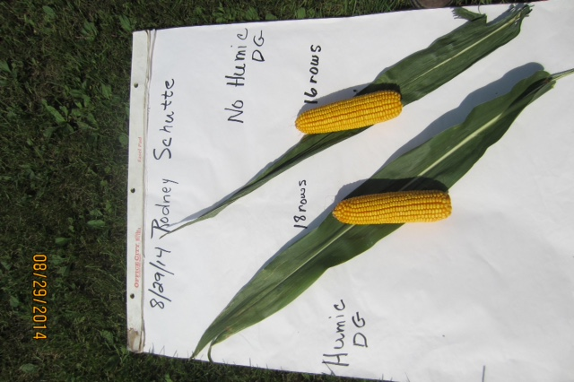
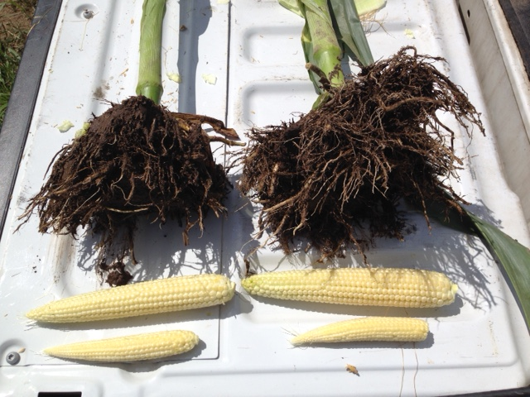
Corn – Missouri,Wisc 2015
Avg. Yield Increase:
Corn – 5-15 Bu, Soybeans- 2-7 bu
15-to 25% Root Mass Increase (D Olk &D Dinnes ;USDA)

Slide 47
Application:
Application Rates of Standard Granular Humate
Broad cast – 100-400 pounds / acre…. In furrow -10-20pounds
Application rates of Humic DG
Broad cast 25-40 pounds / acre .. Best mixed with fertilizer
Bedding , 15-25 pounds per acre
In furrow, 2x2, 5-15 pounds / acre
Equipment
Air Drill, 2x2 ,in furrow etc
Broad Cast ,Urea & Dap, Potash Spinner and Pneumatic
www.AndersonsHumates.com

Slide 48
The Power of Humic DG: Nutrient Efficiency
In a study conducted at The Ohio State University in 2011, Humic DG, applied along with a half rate fertilizer application, resulted in greater dry weight of corn compared to half rate fertilizer alone.
Corn Roots Harvested 1 Month After Treatment
Half Rate Fertilizer
Half Rate Fertilizer + Humic DG
www.AndersonsHumates.com

Slide 49
2013 Humic Rate Study The Ohio State University
Greater leaf count in wheat treated with 25 #/A Humic DG compared to those treated with 100 #/A screened humate.

Slide 50
2013 Humic Rate Study The Ohio State University
Leaf count of tomatoes treated with 25 #/A Humic DG was greater than those treated with 100 #/A screened humate.

Slide 51
The Benefits of Humic DG – soil or crop specific ?
Increased root growth (length & number) observed after application, improvement in leaf size and productivity :
Group 1: Corn, tomato, cucumber, wheat , pepper, carrot, milo, bentgrass.
Group 2: Green beans, sugar cane , sugar beets, canola, strawberries ,alfalfa, oats, dry beans, blueberries,lettuce .
Group 3: soybeans ,fruit trees
Academic Studies: Cooper (1998), Adani (1998), Arancon (2006), Quilty (2011)

Slide 52
Humic DG- soil or crop application?
CEC – lower than 6.5 (sand or clay soil) granular
pH Higher than 5.5 (pH a driver)
Impaired soils – salinity , Bicarbonates etc.
Abiotic Stress liquid
HIGH CEC
Sand (9)
Humic Acid (600+)
LOW CEC
Clay (30)
Humus (150-250)
0 300 600+
milliequivalent
Brady & Weil, The Nature and Properties of Soils, pg 341, 514;
http://aggie-horticulture.tamu.edu/newsletters/hortupdate/hortupdate_archives/2002/jun02/art4jun.html
http://www.spectrumanalytic.com/support/library/ff/CEC_BpH_and_percent_sat.htm

Slide 53
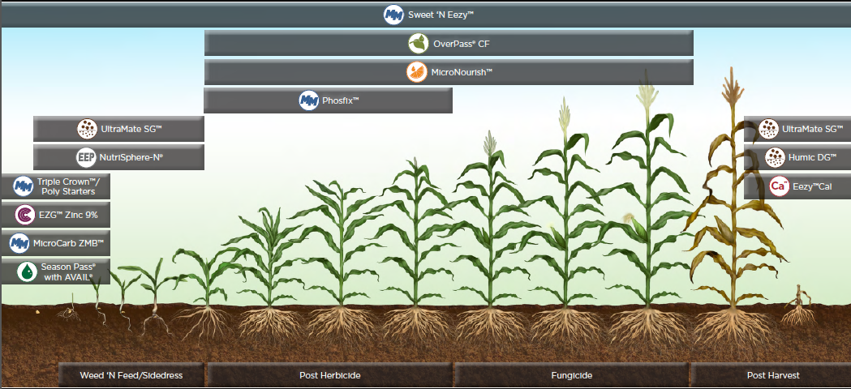
Corn Growth System- Timing

Slide 54
HUMIC DG – A Better Value !!!!
Determining Rate in Use :
To many variables to determine a rate in use
Including :
Native Soil Type
Base nutrition
Soil pH
Salt / bicarbonate Impairment
Pathogen pressure

Slide 55

Soil Levels of Humics*
A recommend range of 10-50 ppm humic substances in agricultural soils for optimum soil health and plant growth.
To achieve optimum soil levels consider:
Humus (1 ppm) | Required lbs. of Humic Acid/acre | Required lbs. of Humic DG/acre | Required Gal. of 12% liquid
1 | 3 | 5 | 3 gal. / 26.25 lbs.
5 | 15 | 24 | 14.25 gal. / 124.7 lbs.
10 | 30 | 50 | 47.61 gal. / 417 lbs.
50 | 150 | 240 | 143 gal. / 1251 lbs.
* 1 acre of soil weighs about 2 million lbs. (depth of 8”)

Slide 56
HUMIC DG – A Better Value !!!!
Influences Fertilizer Use efficiency
Nitrogen utilization and stabilization, Allows Phosphorus ion to remain stable in soil
Dual Sources of Carbon - Humate and Humic acid precursor
Higher Humic Concentration…liquids and Granular comps.
Dispersible – self incorporating- more surface area
Wider range of humic substances for nutrient efficiency
Economics

Slide 57
Suggested Product Use
Product | In-Furrow | Insecti-cide Box | 2x2 Starter | Liquid Fertilizer | Dry Fertilizer | Low pH Tank Mix | Broadcast | Air Drill | Irrigation | Foliar | Crop Residue
Humic DG |  | X | X |  | X |  | X | X |  |  | X
Black Gypsum DG |  | X |  |  | X |  |  | X |  |  | X
HCU |  |  |  |  |  |  | X |  |  |  | X
UltraMate LQ | X |  | X | X |  | X | X |  | X | X
K-Mate SG | X |  | X | X | X |  | X |  | X | X
MicroCarb ZMB | X |  | X |  |  |  |  |  |  | X

Slide 58
Cost in Use
USE | Rate (lb) / Acre | Rate of HA (lb)* / Acre | Cost / Acre
Air Drill / In -Furrow | 5-10 | 3.5-7.0 | $4.30 - $8.60
BROADCAST W/ UREA | 10-20 | 7.0-14 | $8.60 - $17.40
Strip Till | 7 -10 | 4.9-7.0 | $6.04 - $8.70
Crop Residue - Potash | 10-15 | 7.0-10.5 | $8.70- $13.80
*Compared to HA rate of a 12% liquid humic acid at 1 lb of HA/gal. Based on Bag price or tote
www.AndersonsHumates.com

Slide 59
Humic DG Summary
Complexing of nutrients in the soil (Chelation)
Increases soil microbial life (about 50% C)
Increases “CEC” holds nutrients from leaching
Improves water penetration and root mass
Best applied in rhizosphere

Slide 60
Black Gypsum DG
Black Gypsum is a unique bio-amendment that combines natural dihydrate gypsum and humic acid into a homogenous dispersible granule (DG).
2 formulas available:
48% calcium sulfate, 21% humic acid
70% calcium sulfate, 10% humic acid
Blends with fertilizer or spreads alone
Improves root mass, plant nutrient uptake and phosphorus stability
Provides humic acid, soluble calcium and sulfur in one package and in amounts equal to most 12% liquid applications

Slide 61

(
Why Black Gypsum DG (21)
Specification: Black Gypsum DG (21)
Contains :
70.0% Calcium Sulfate Dihydrate - 17% Calcium, 13% S (85/15)
10% Activated Humic Acid
7% Plant based Organic acids (HAP)
Supplies 15.0 – 22.5 Lb of actual activated HA / acre
SGN 240 – BULK
Designed to remediate soil issues
Lower price to deliver HA & Ca and S
Same Physical Character to maximize equipment assets and Blending
Compete head-to-head with competitor product
Very favorable to FGD price; Better Agronomics
Synergy between Humic and Gypsum strengthening claims and performance
Broad are application vs Humic DG

Slide 62
Black Gypsum DG
Features and Benefits
Dispersible Granule Technology
Increases calcium and sulfur without changing soil pH
Supplies 15-30 pounds of humic acid per acre
Enhances soil health by stimulating soil microbial populations
Relieving soil compaction and salinity
Delivers two types of plant available, water soluble carbon

Slide 63
Black Gypsum DG – Salinity Reduction
Black Gypsum DG applied at 200 #/A results in a greater initial reduction in salinity, as compared to “Brand X.”
Notes:
Black Gypsum at 200 #/A reduced cumulative salinity by 7.7%
“Brand X” at 200 #/A increased salinity by 3.2%

Slide 64


What Drives Efficiency?
Sub Particle Size
Self Incorporation
Dual Carbon Source
Concentation of Humic Acid
Improves soil bound nutrient efficiency

Slide 65
Ideal NPK / Humic Blending Partner
Compatible with Standard NPK materials
Not hydroscopic in nature
Uniform spreading and swath width and flowability
Low Dust
Good Storage stability … bag or bulk

Slide 66

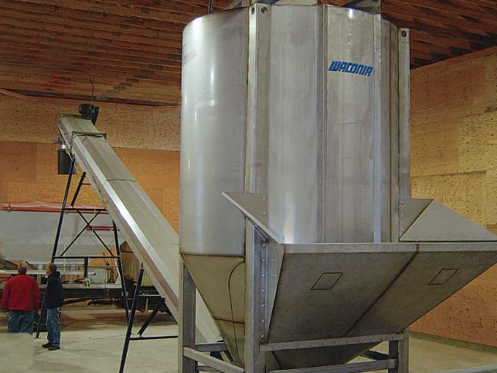
Key properties of Humic DG as an ideal raw material in Agricultural fertilizer blending
Uniform Granular Size
Compatible Particle Density
Uniform Particle Shape
Crush strength-
Flowability (Moisture)
Ideal Coefficient of friction -

Slide 67
Blending Characteristics
Black Gypsum DG (10)
Humic DG
RTA: >90%
Avg. Crush Strength: > +6
Bulk Density: 50-55 lb /ft3
Moisture: < 5%
pH: 5.8-6.2
SGN -260
RTA: > 94%
Avg. Crush Strength: >1.4 - 3.0
Bulk Density: 44-46 lb/ft3
Moisture: < 5%-7%
pH: 3.1-3.9
SGN 240

Slide 68
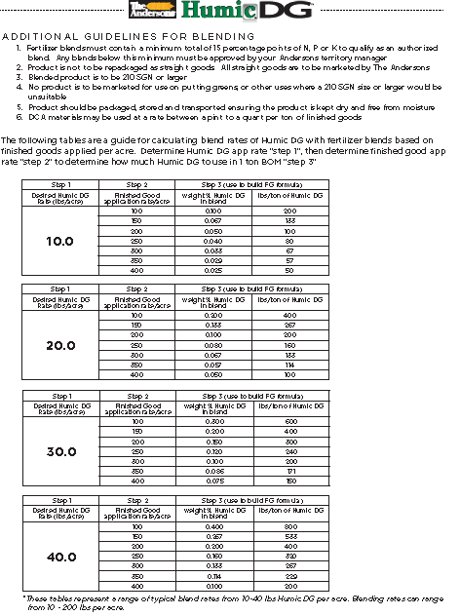
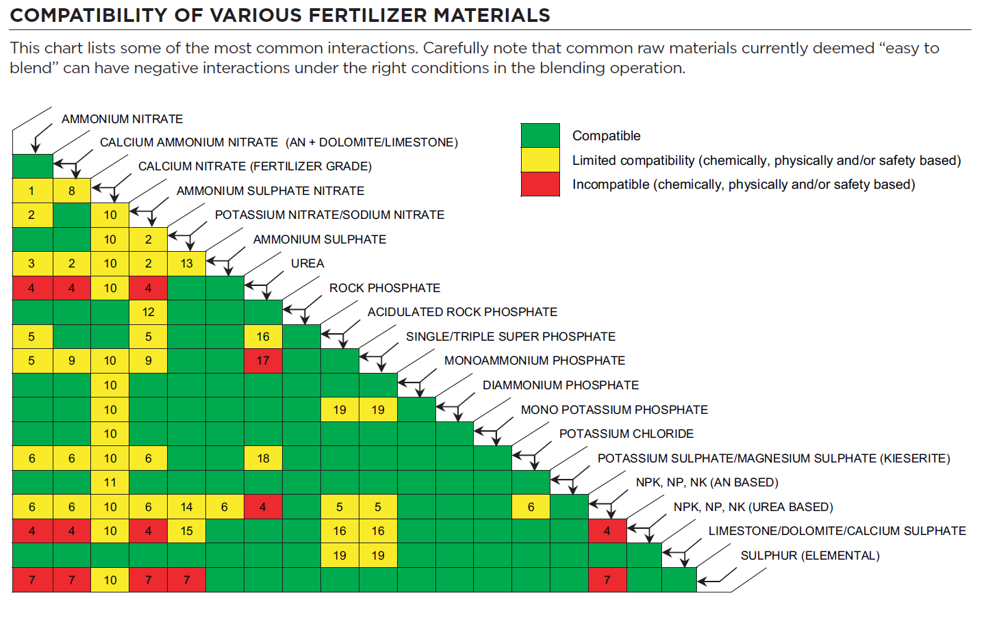
HUMIC DG Blending Guidelines – Compatible with Conventional NPK
Blending
Co Branding
Marketing
Standard Industry Chart

Slide 69
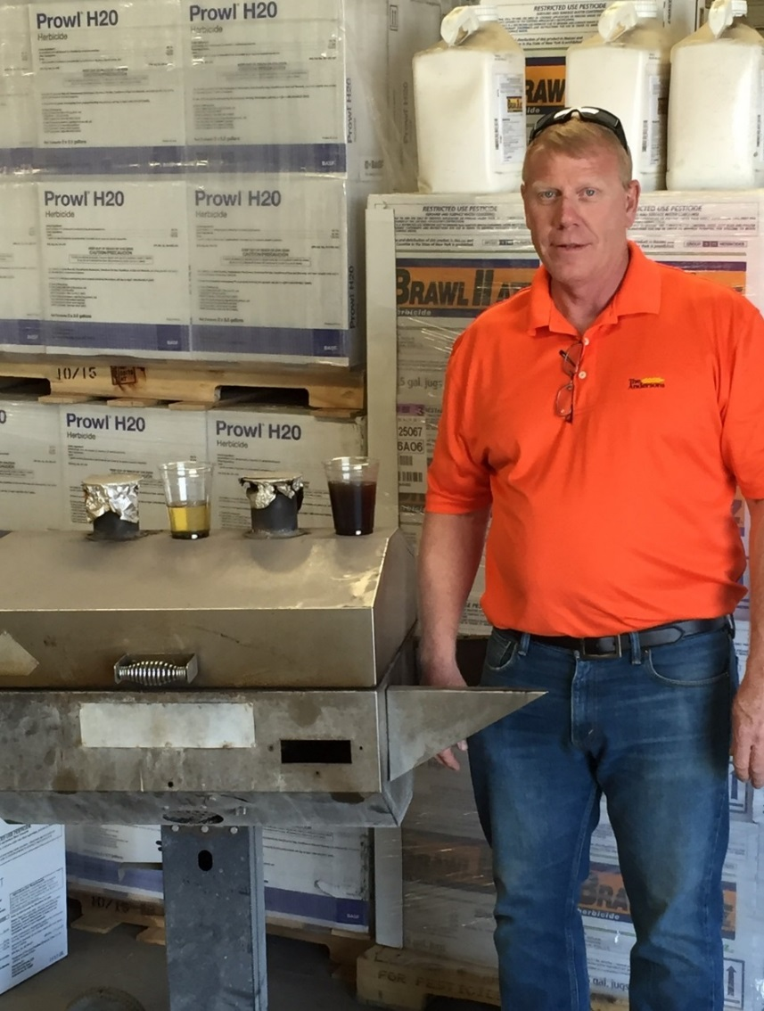
The Andersons’ Humic Technology in Action
Competitor
Andersons LQ & DG
www.AndersonsHumates.com

Slide 70

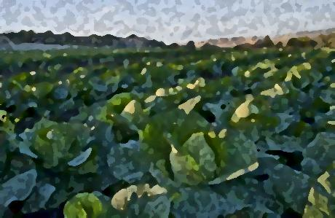
To The Future & To Good Crops…
Thank You!
www.AndersonsHumates.com

